Slide 2
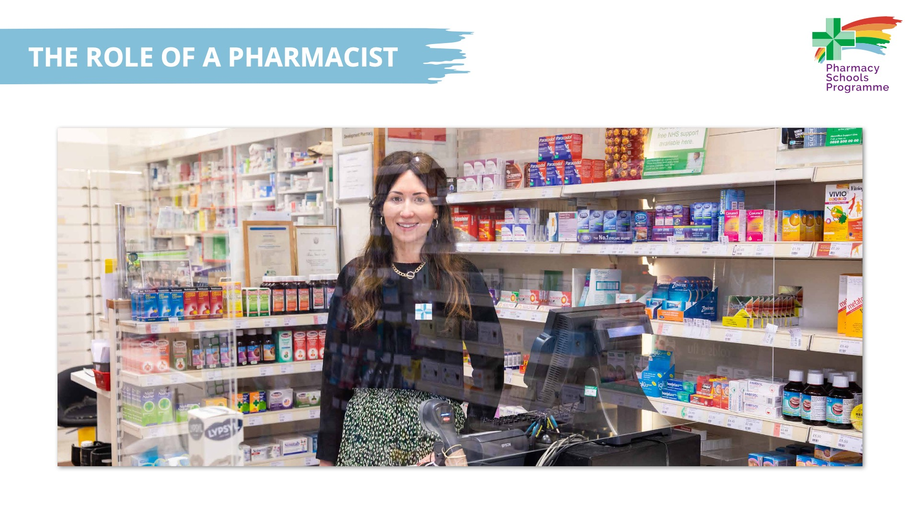

Slide 3
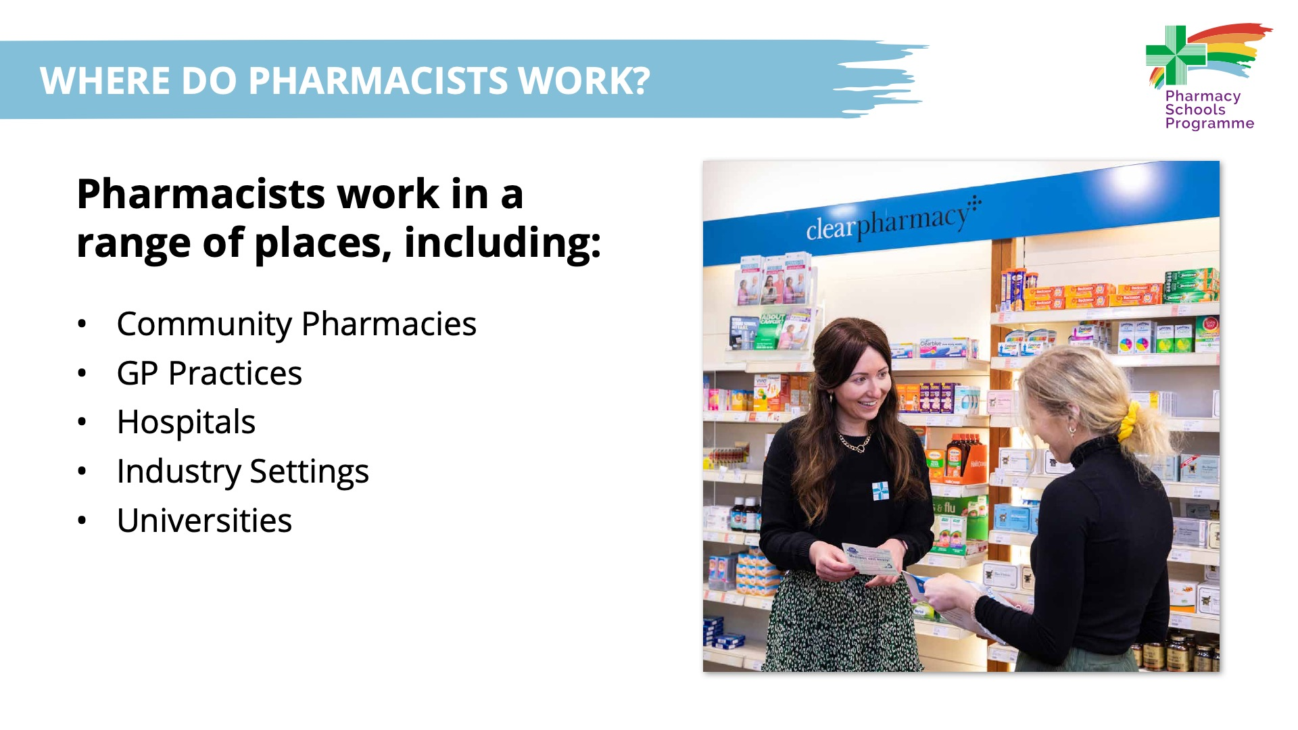

Slide 4
Notes:
Community Pharmacists work in pharmacies in villages, towns and cities across Northern Ireland.
Many can be found by looking for the green pharmacy logo.

Slide 5
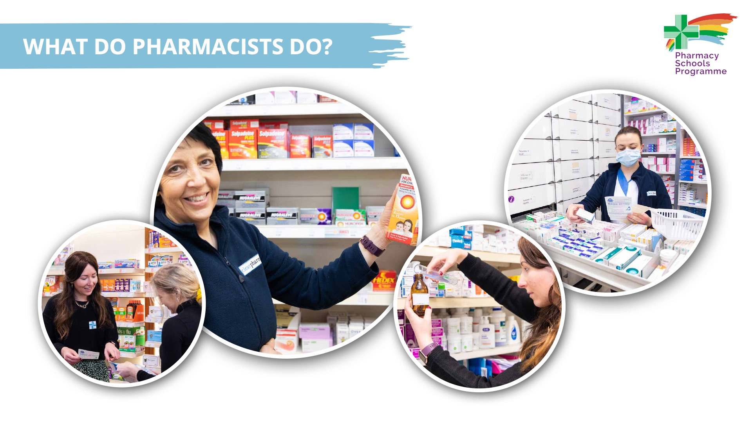
Notes:
Pharmacists have an important role in improving the health of everyone by giving prescriptions and supporting people choose the right medicine over the counter.

Slide 6
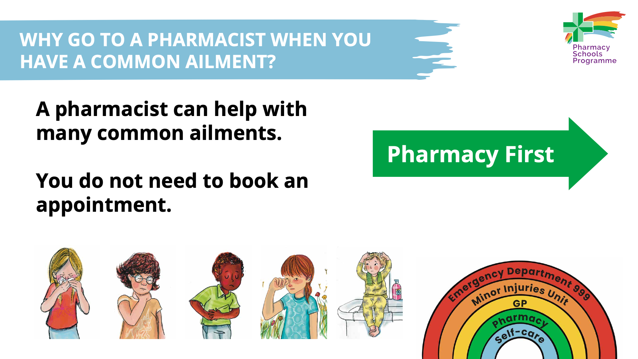
Notes:
A Pharmacist can help with many common ailments, such as colds, diarrhoea, hay fever, head lice and sore throats.
You do not need to book an appointment to see a pharmacist – you can walk straight in.

Slide 7
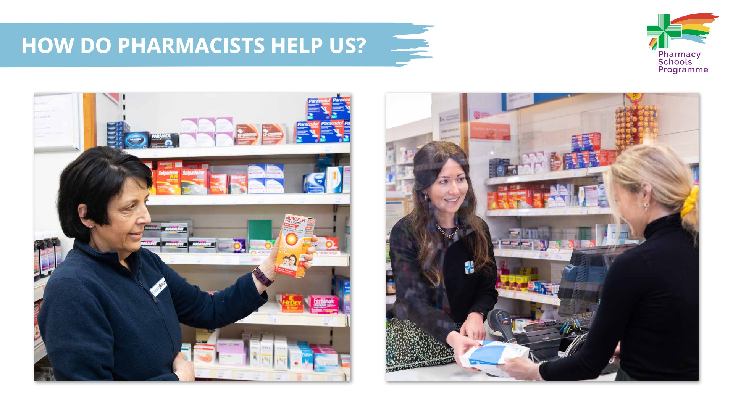
Notes:
Pharmacists offer advice and help people choose a medicine to help them get better.

Slide 8
Notes:
Pharmacists can give advice on a wide range of issues, including your mental wellbeing, how to exercise and how to stop smoking.

Slide 9
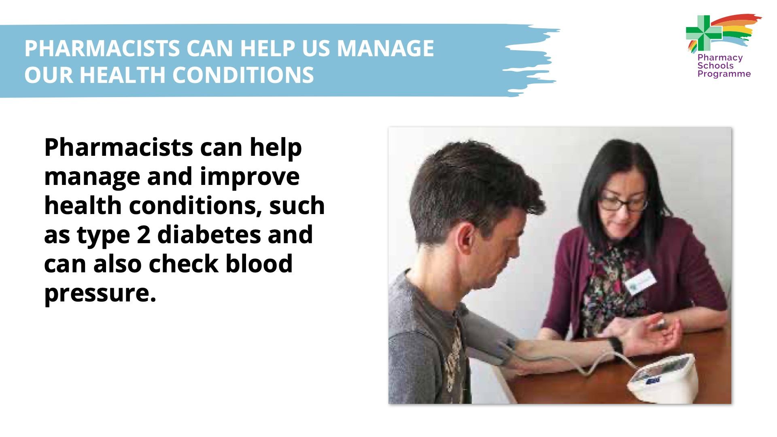
Notes:
Diabetes - They can check to see how you are managing the condition, offer advice and leaflets on your condition and liaise with other health professionals if further help is needed
Some people need to have their blood pressure taken regularly, and so it can be easier to visit the pharmacy rather than the doctor.

Slide 10
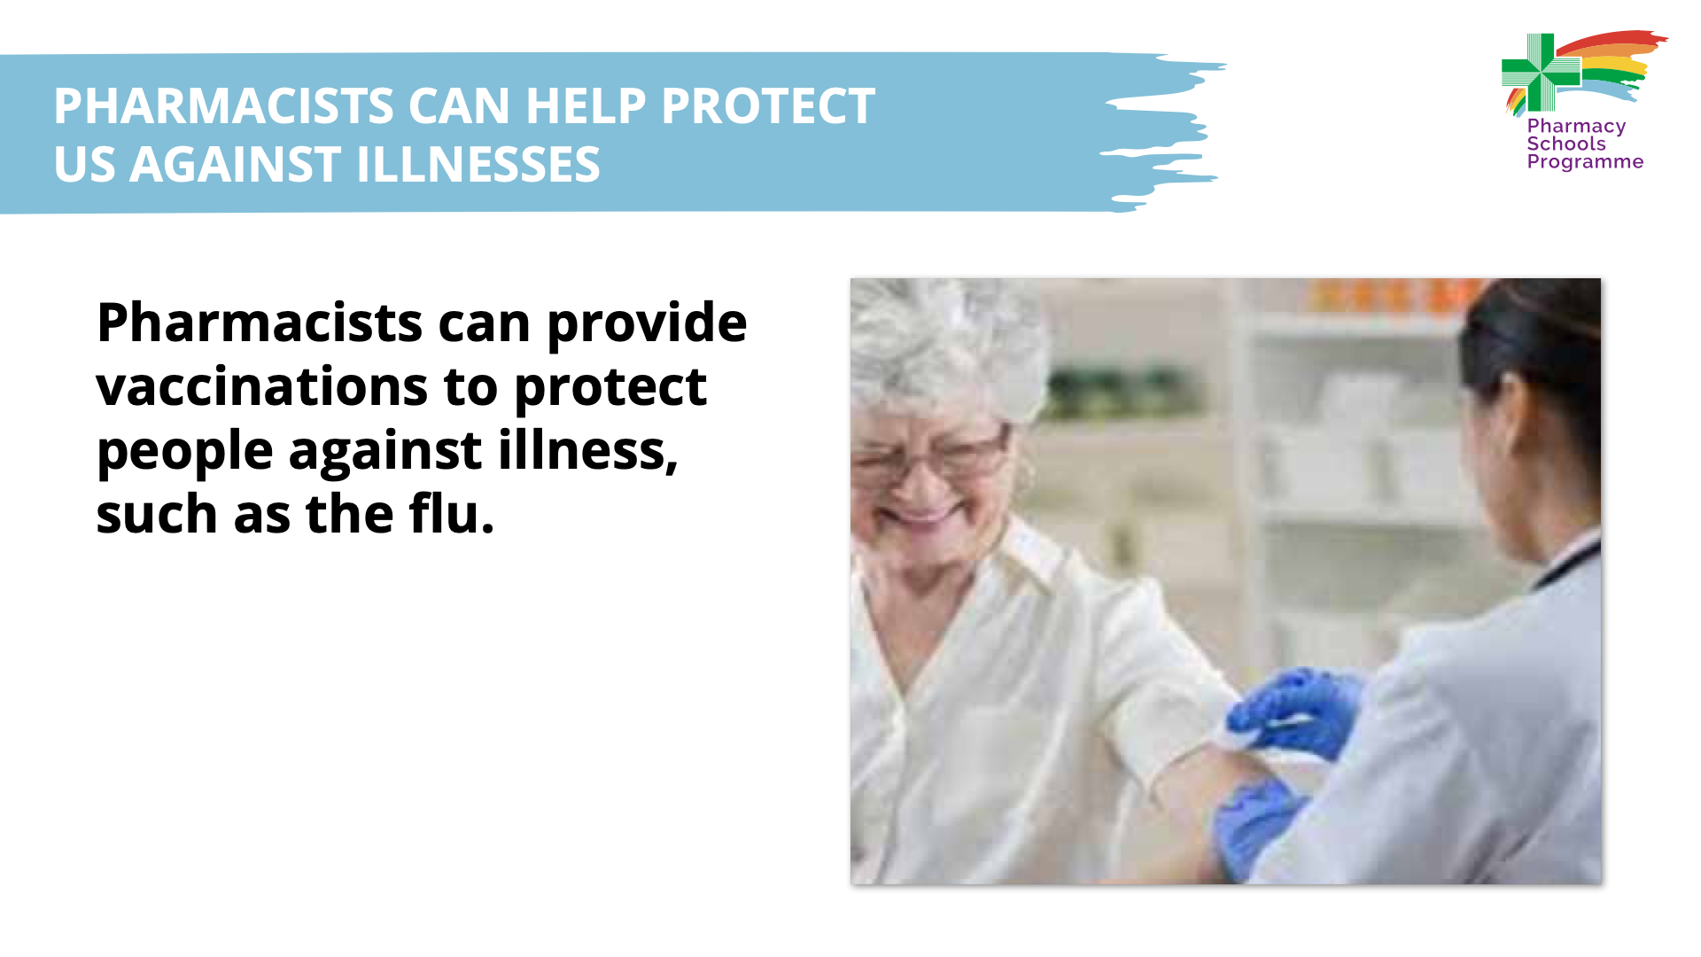
Notes:
Pharmacists can provide vaccinations to protect people against illness, such as the flu. Vaccinations help the body to protect against certain illnesses.

Slide 11
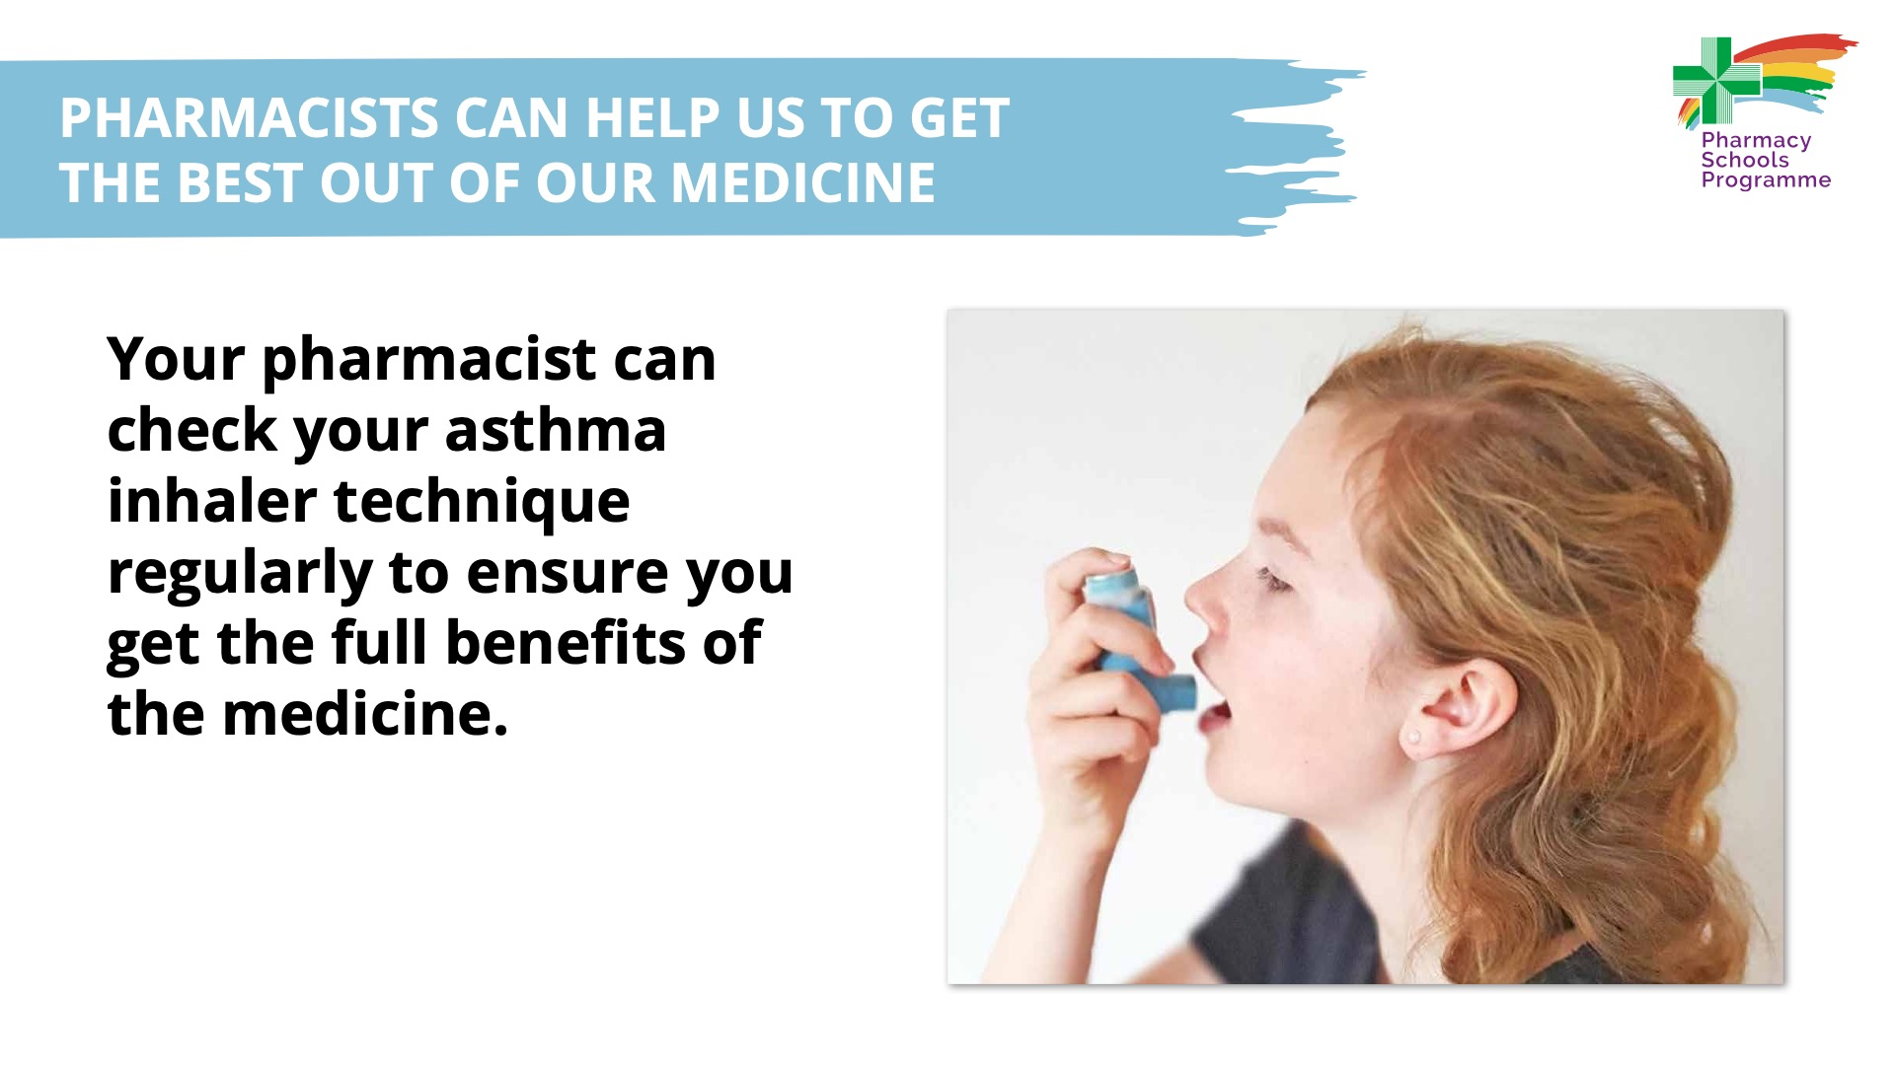
Notes:
Your pharmacist can check your asthma inhaler technique regularly to ensure you get the full benefits of the medicine.

Slide 12
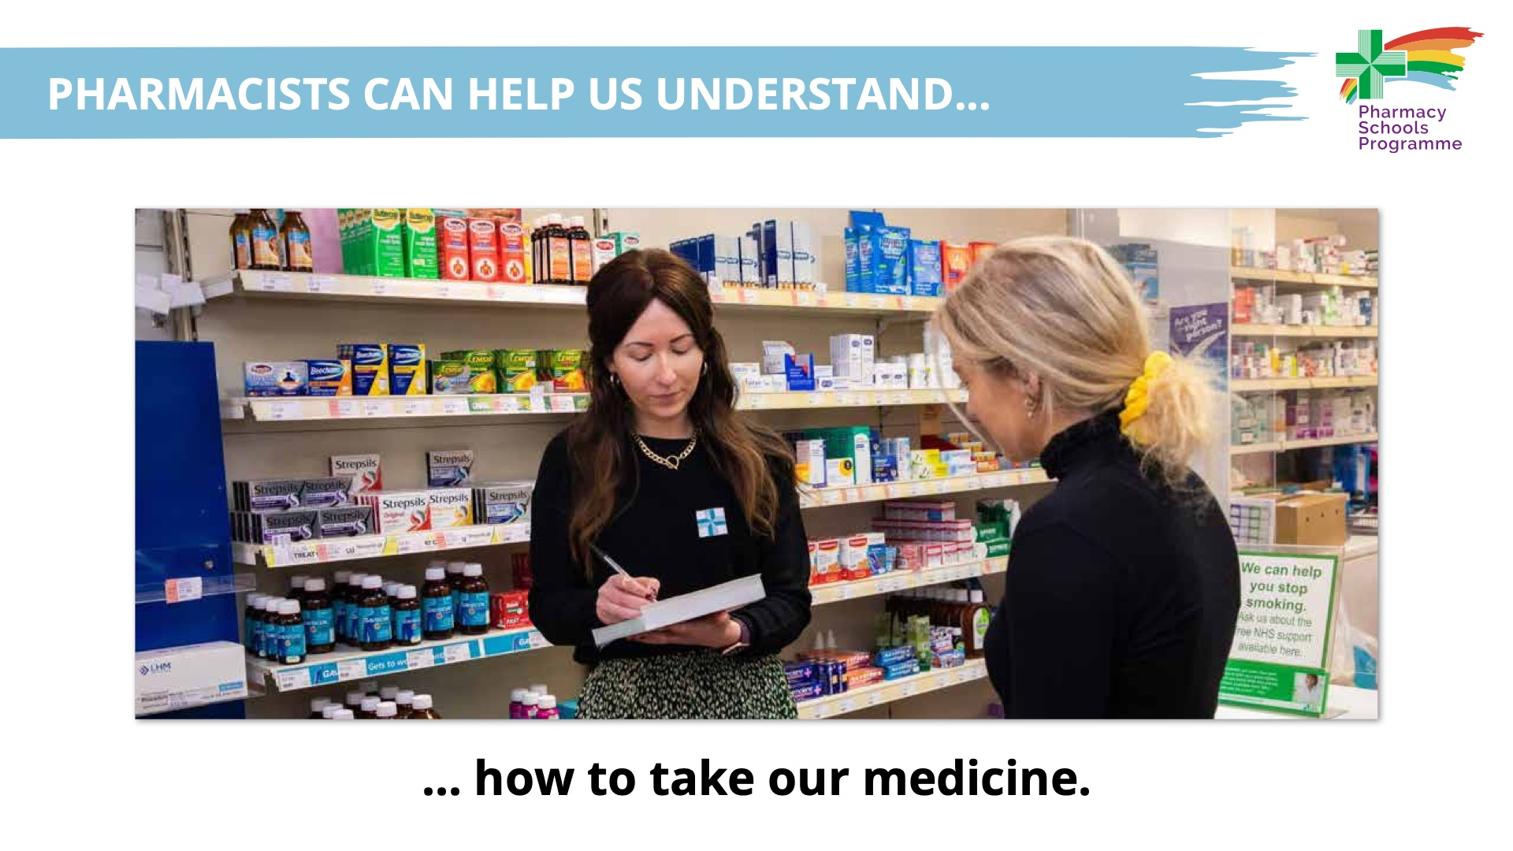
Notes:
Some people can find it hard to understand when and how often to take their medicine and to manage any side effects that the medicine may cause.

Slide 13
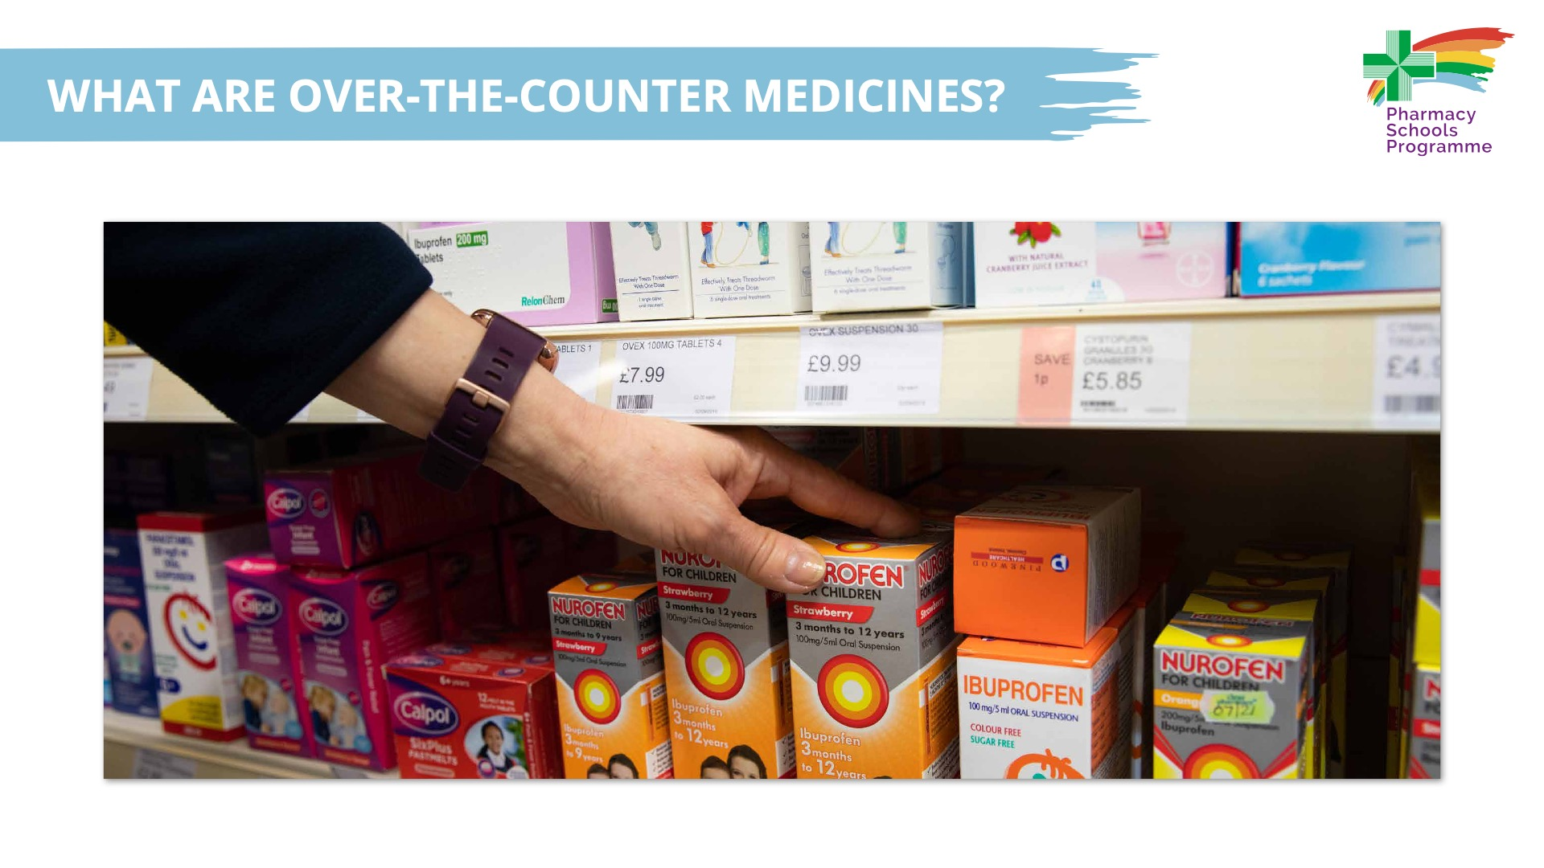
Notes:
Pharmacists can offer advice on over-the-counter medicines. These are medicines available to buy in pharmacies, supermarkets or local shops and which you do not need to go to the Doctor for.

Slide 14
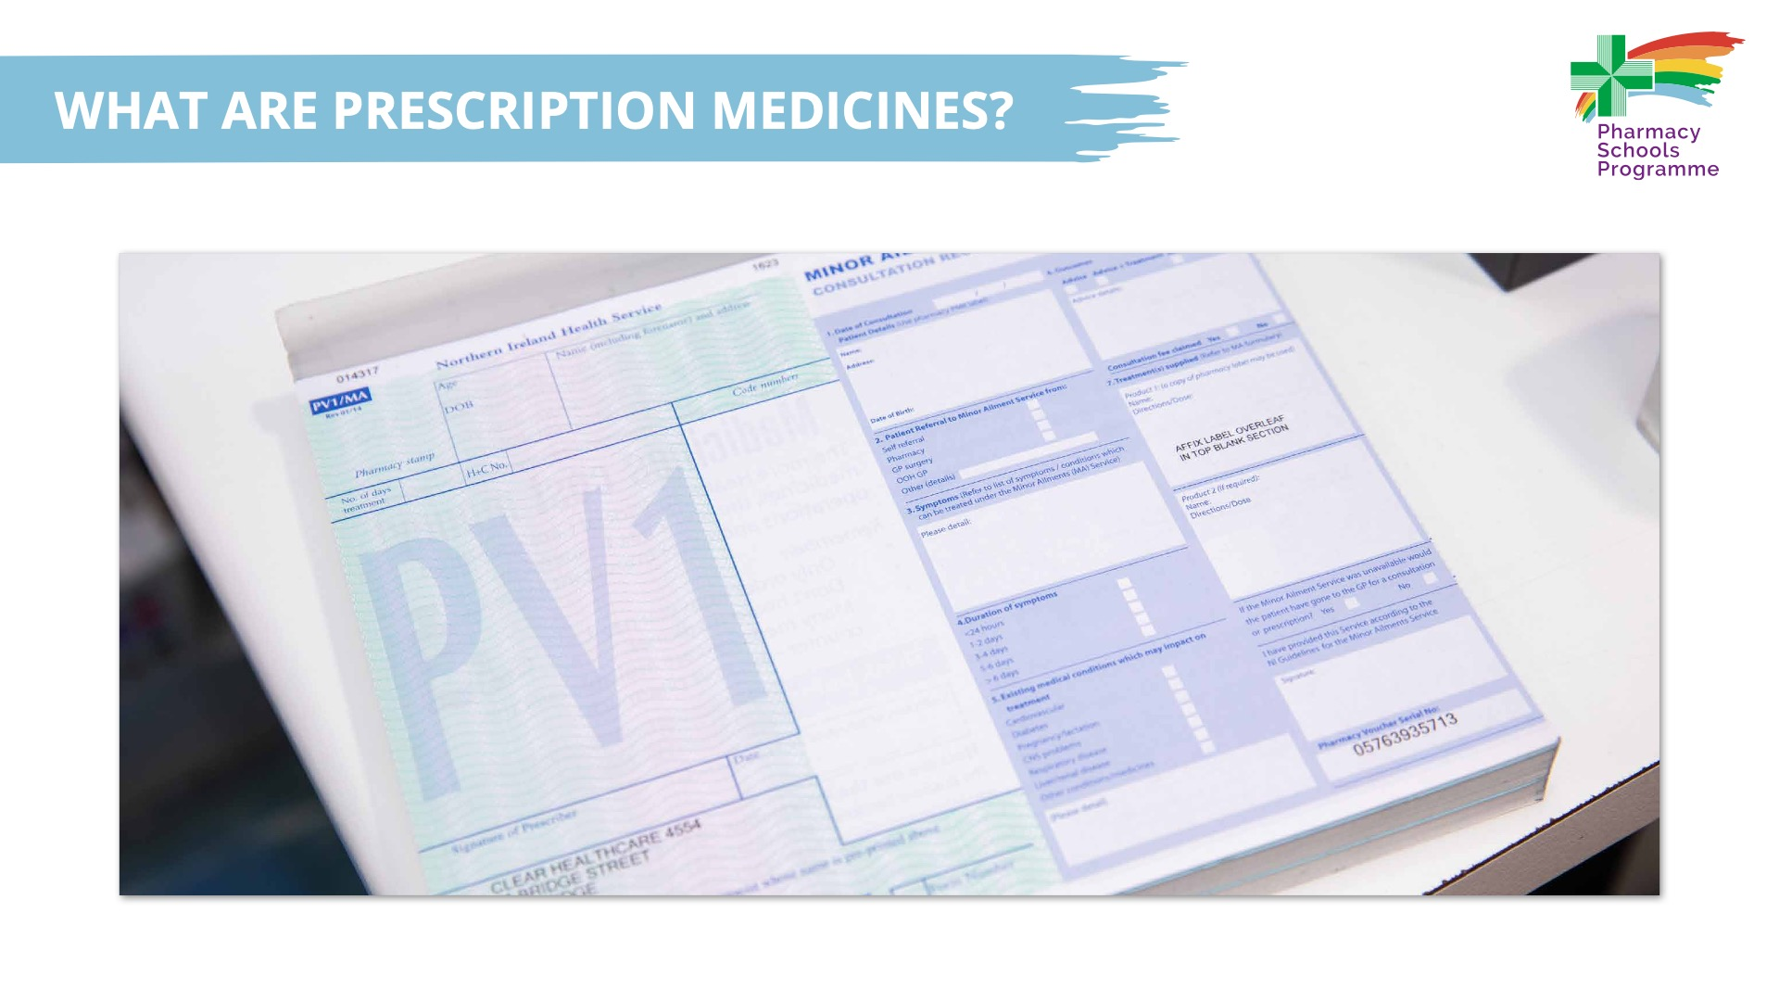
Notes:
Prescription medicines are prescriptions (an instruction for a medicine) given by a health professional, such as a doctor, nurse or pharmacist to help you get better
In Northern Ireland, all Health Service prescriptions are free for everyone. However, private prescriptions from a specialist are not free for anyone, so you would have to pay for them
Prescriptions can be written for many different forms of medicines, such as creams, lotions, drops, tablets, liquids, inhalers and injections

Slide 15
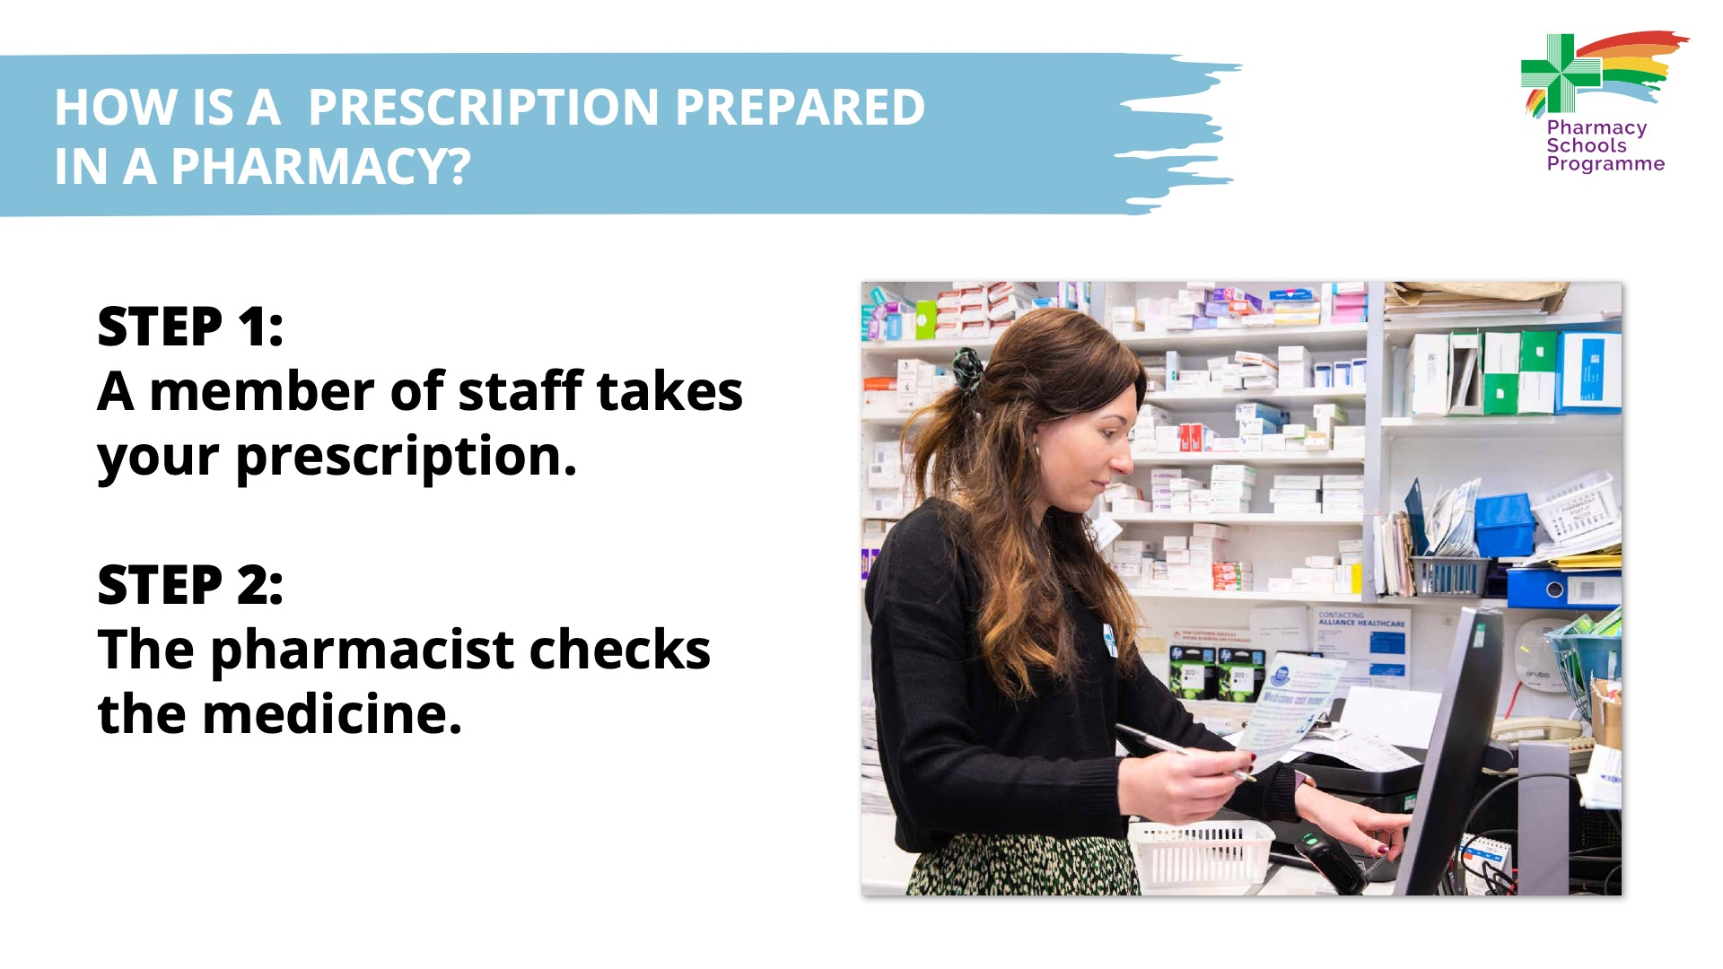
Notes:
Step 1: a member of the pharmacy team takes your prescription from you for dispensing
Step 2: the pharmacist checks the medicine is safe and the right medicine for you

Slide 16
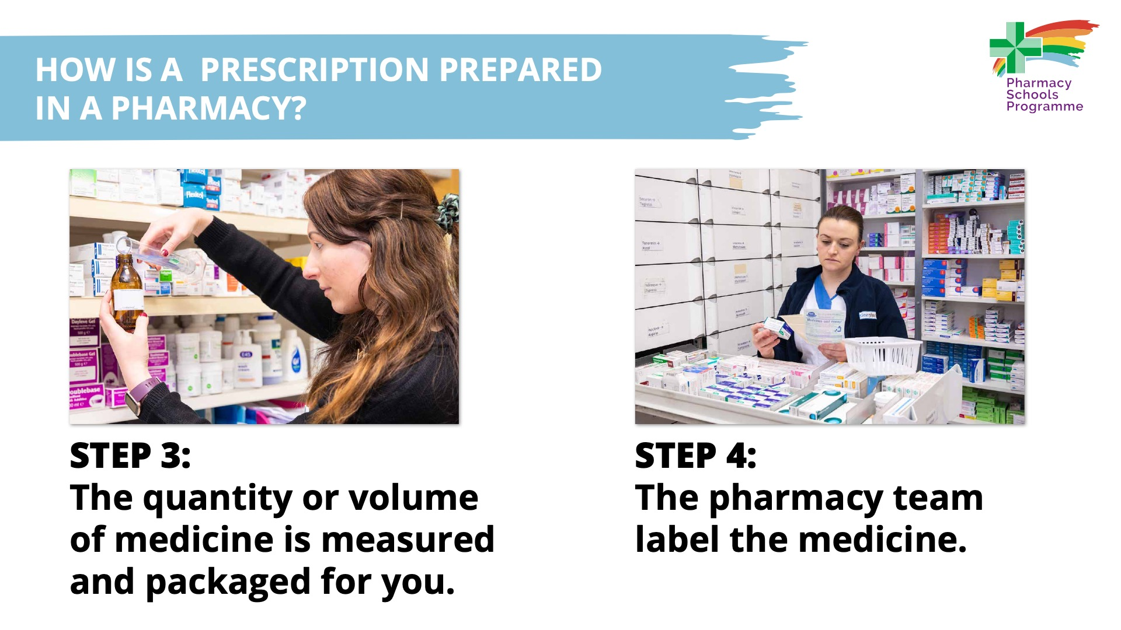
Notes:
Step 3: the quantity or volume of medicine is measured and packaged for you
Step 4: the pharmacy team produces a label which is placed on the medicine

Slide 17
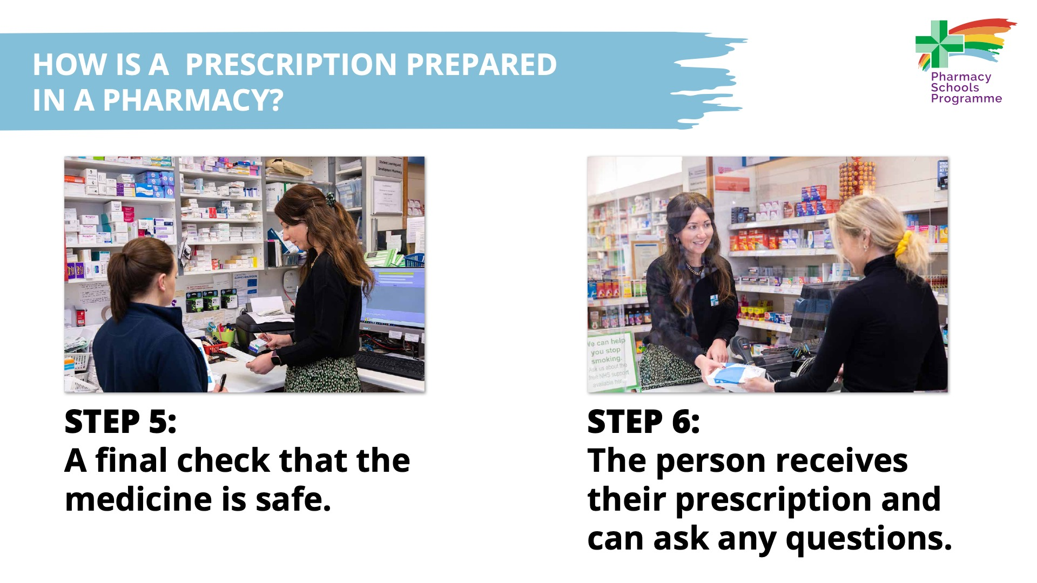
Notes:
Step 5: a pharmacist or trained technician carries out a final check that the medicine is safe
Step 6: the pharmacist hands the finished prescription to the patient, explaining how to take the medicine and answering any questions

Slide 18

Notes:
Know your medication
Check that you are using the right medication in the right way
Ask a healthcare professional, such as your doctor, nurse or pharmacist, if you are not sure.
Know-Check-Ask is part of the ‘Medication Without Harm’ campaign that highlights that everyone has a role to play in medication safety. The message is simple: before you prescribe, dispense or take medicine make sure you know about it.
The three simple steps children, along with their parent/guardian/carer or significant other, can take are:
Know your medication
Check that you are using the right medication in the right way
Ask a healthcare professional, such as your doctor, nurse or pharmacist, if you are not sure.
The message is that lots of people will require medication at some point in their lives, and by taking these steps it will ensure they take their medicines safely.
Though part of the video is directed at health professionals, the simple message of ‘Know-Check-Ask’ will start to help children understand their role in using their medication safely.

Slide 19
