Slide 1

Healthy Transport
Unit 1

Slide 2
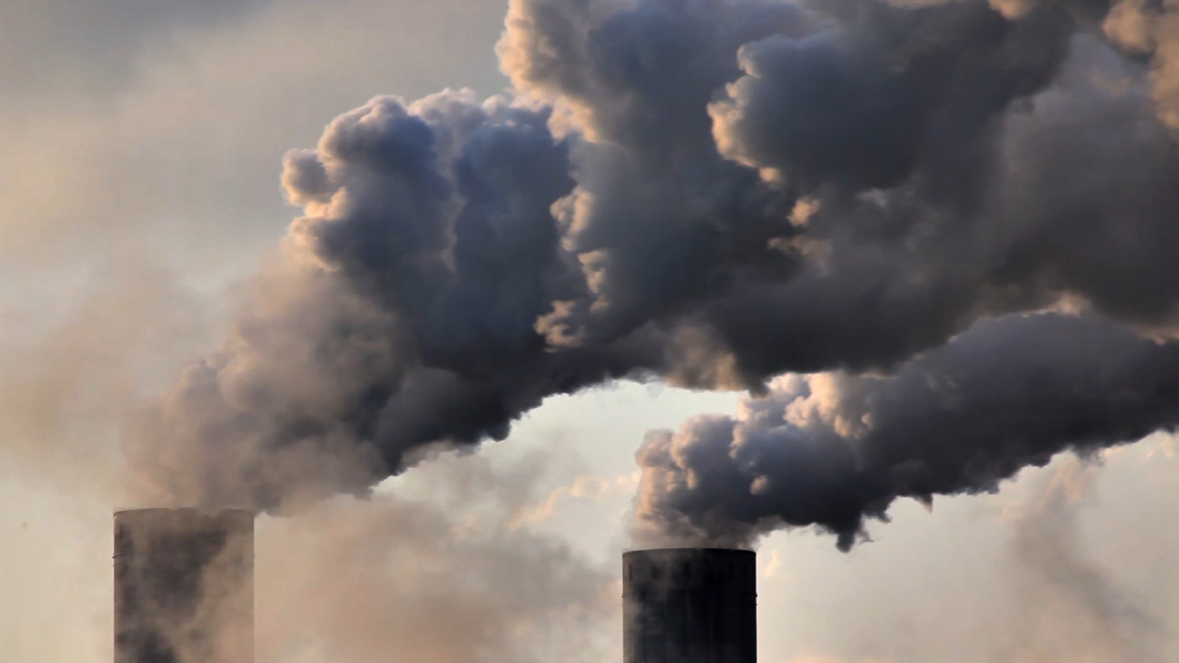
Unit 1: Air Pollution

Slide 3


What is Air Pollution?
A mix of liquid and solid particles and gases that get stuck in our air, they make it dirty and unhealthy for our bodies and the planet.
Notes:
Air pollution comes from cars, planes, trains, factories

Slide 4
Harmful Gases
Nitrogen Dioxide (N02)
Carbon Monoxide (CO)
Ozone (O3)
Notes:
Different Types of Air Pollution
NO2: red/brown gas comes from chemical reaction from power generation, burning of fossil fuels for home heating, road transport (petrol, oil, diesel compounds)
CO: colourless, odourless gas, burning of fuels and vehicles, can get into homes from cooking and houses should have CO monitors to prevent from too much carbon monoxide in homes which can be fatal
Ozone: naturally occurring gas, protects from harmful rays of sun, but when it gets trapped in the ground and reacts with emissions form vehicles it can cause major health effects on lungs and breathing
Reference: Llywodraeth Cymru Welsh Government (n.d) Types of Pollution Sources. https://www.airquality.gov.wales/education/air-your-view/types-pollution-and-their-sources

Slide 5
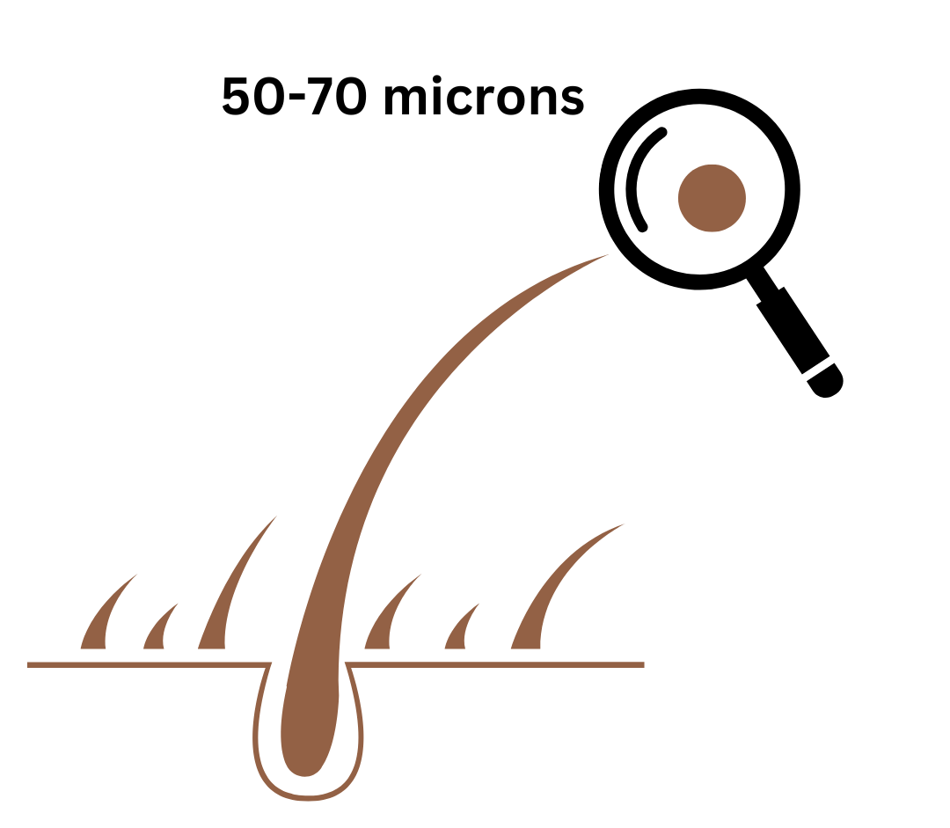
Particles
PM10
PM2.5
Notes:
Particles are measured in microns, look at a piece of your hair , your hair is 50-70 microns thick in size but larger air pollution PM10 which are larger particles made up of PM2.5 particles from burning fuels and road transport as well as mould, dust and pollen are only 10 microns
And the smallest size of air pollution PM2.5 which is only 2.5 microns, think how much smaller than your hair this is! This kind is the most harmful, come from industrial processes, vehicles and forest/wildfires
Reference: Llywodraeth Cymru Welsh Government (n.d) Types of Pollution Sources. https://www.airquality.gov.wales/education/air-your-view/types-pollution-and-their-sources
EPA (2020) Particle Pollution Activity –Paper Wad Game https://www.airnow.gov/sites/default/files/2021-01/paper-wad-activity-12-20.pdf

Slide 6



Smog
Notes:
Smog is a type of air pollution that occurs when air pollution from cars and factories mixes with the hot air and sunlight, it gets trapped by the buildings and warm air and stays at ground level. Making the air thick, dirty and polluted. This makes it harder to see and breath and can kill plants

Slide 7
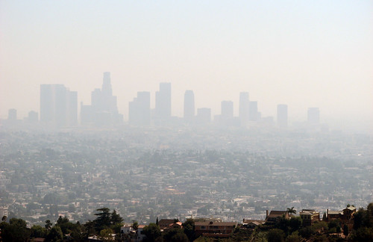
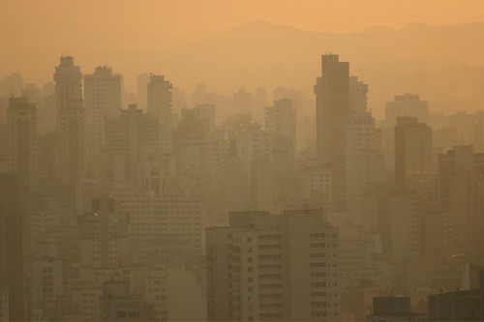
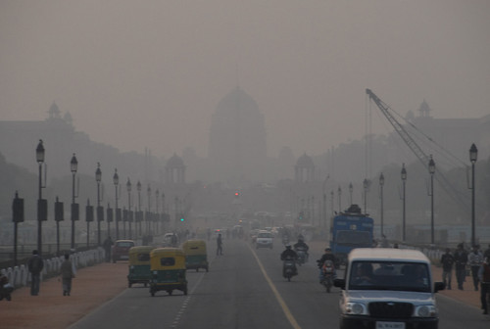
Smog In Cities
This Photo by Unknown Author is licensed under CC BY-NC
This Photo by Unknown Author is licensed under CC BY-SA
This Photo by Unknown Author is licensed under CC BY-NC
Notes:
Cities are warmer, have more cars and more buildings which makes it easier for smog to be created and trapped.
These pictures show was smog in cities can look like.

Slide 8




Ways to reduce air pollution:
Walk and Cycle
Make less trips in the car
Plant more trees

Slide 9
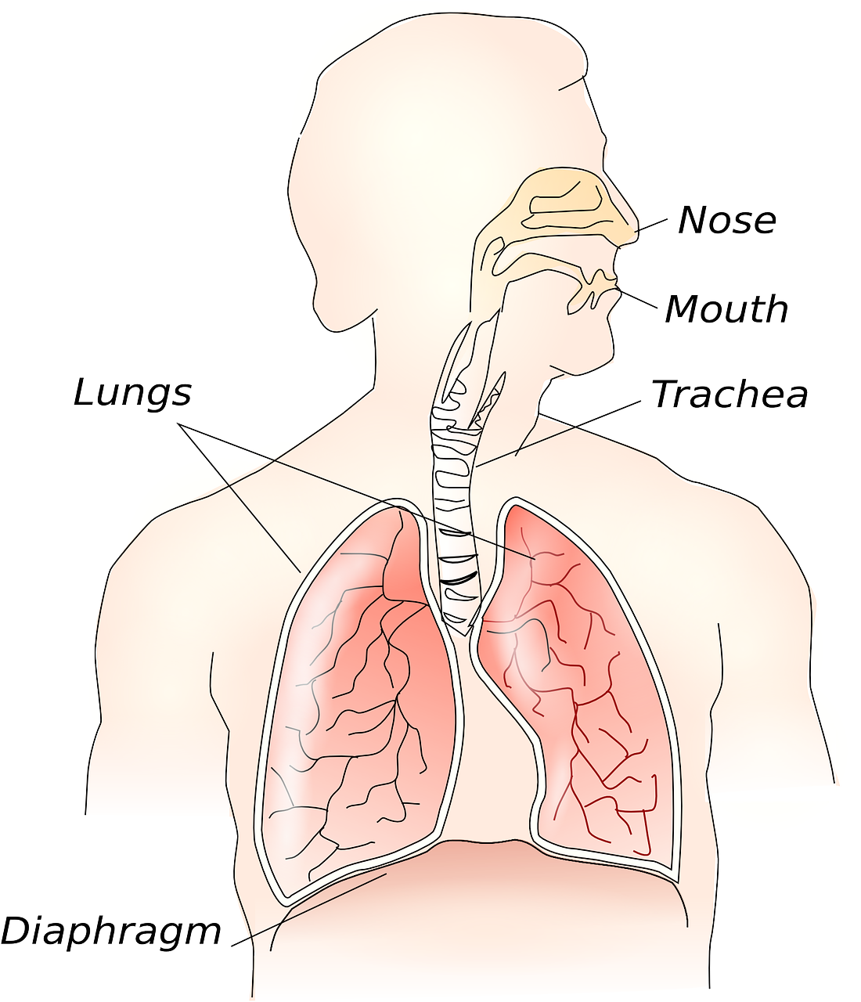
Respiratory System
Notes:
The cells inside our body need oxygen to stay alive and do their job for our bodies. The respiratory system works with the lungs to allow us to breath by bringing in oxygen and removing carbon dioxide. The respiratory system is made of up of our nose, mouth, trachea and diaphragm.
References: KidsHealth (2023) Your Lungs & Respiratory System, https://kidshealth.org/en/kids/lungs.html

Slide 10
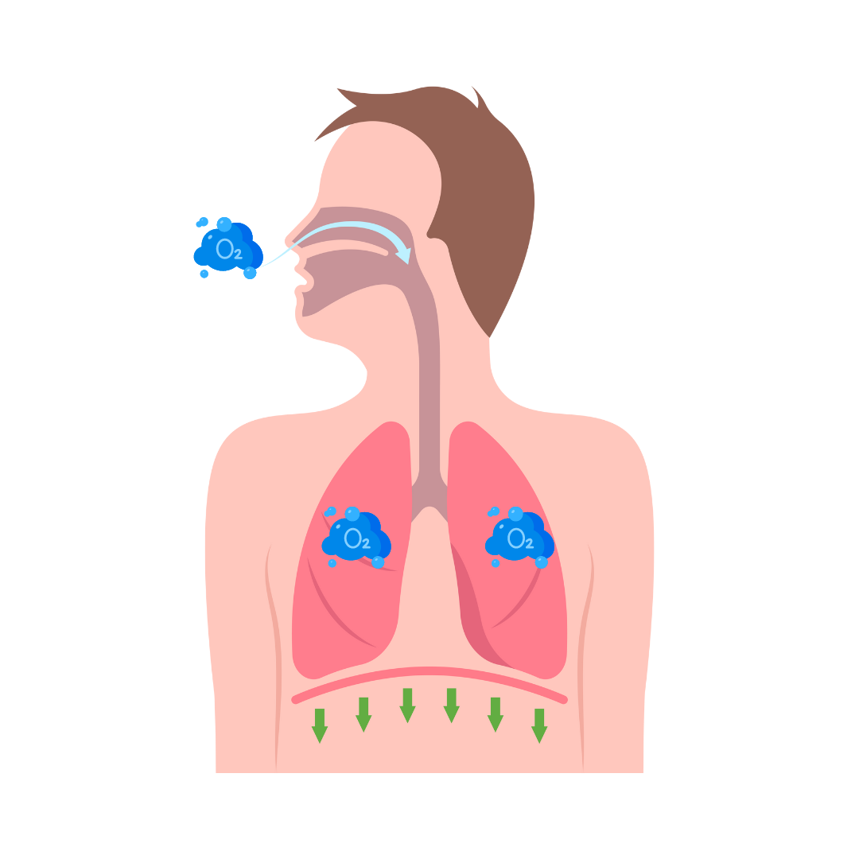
Breathing In
Oxygen goes in
Chest moves out
Diaphragm moves down
Notes:
Air is pulled through the nose or mouth into the lungs, when you breath in and the diaphragm moves downward and the rib muscles pull the ribs upward, allowing you to take a big breath.
References: KidsHealth (2023) Your Lungs & Respiratory System, https://kidshealth.org/en/kids/lungs.html

Slide 11
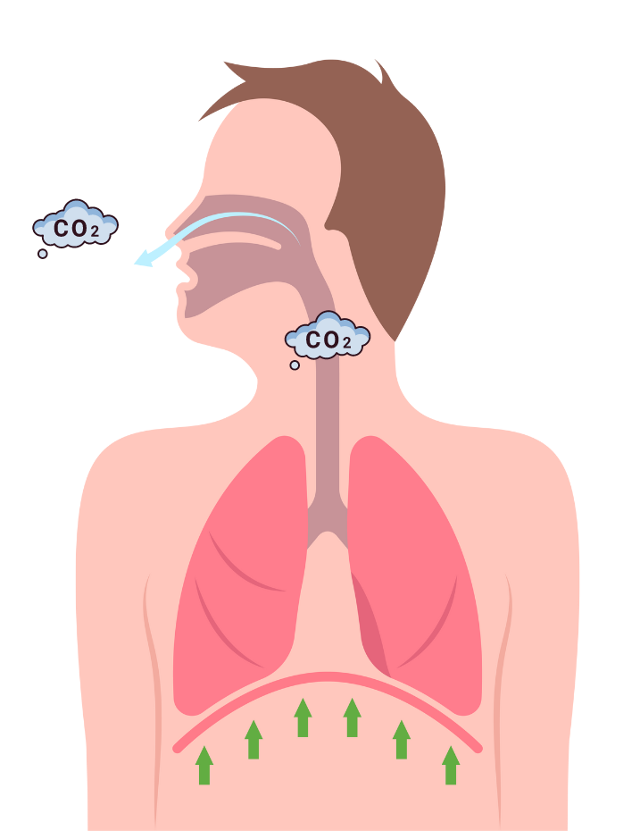
Breathing Out
Carbon Dioxide goes out
Chest moves in
Diaphragm moves up
Notes:
When we exhale the diaphragm moves upward and the chest muscles relax, pushing the air out through your mouth or nose.
References: KidsHealth (2023) Your Lungs & Respiratory System, https://kidshealth.org/en/kids/lungs.html

Slide 12
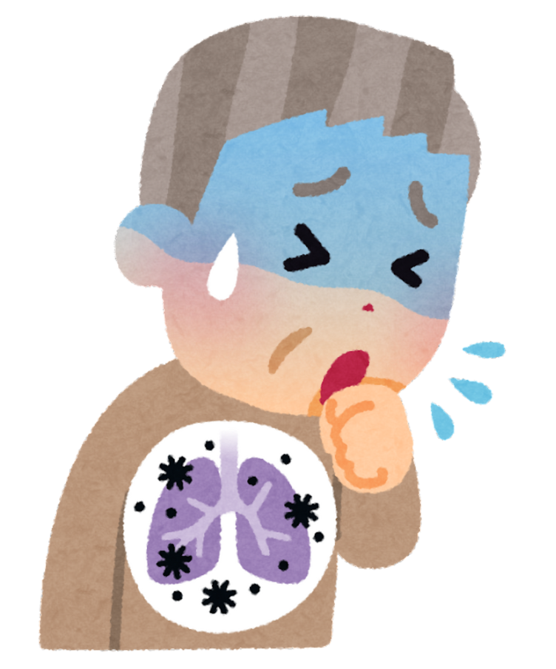
Air Pollution gets inside side our lungs, making it harder to breath and can cause damage.
Notes:
When we breath in air pollution harms out bodies
It makes it harder to breath
It can damage our lungs
The more air pollution we breath in the more harm it can cause as we get older

Slide 13
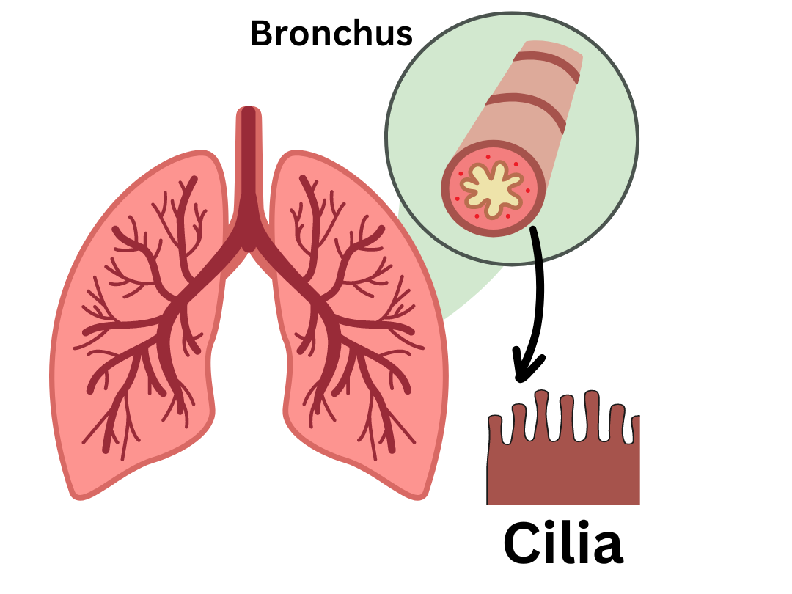
Notes:
Our body must get rid of air pollution from inside our body. This is a close-up picture of the human lungs. Cilia are inside many parts of the body and act as protection they are located in the bronchus tubes of the lungs and are tiny hairs that protect and filter particles such as air pollution out of the lungs.
EPA (2020) Particle Pollution Activity –Paper Wad Game https://www.airnow.gov/sites/default/files/2021-01/paper-wad-activity-12-20.pdf

Slide 14
Pollution Particle Tag
Air Pollution: Learning Activity A Option 1
Notes:
See Key Stage 2 Booklet for Instructions

Slide 15
Source, Solution or Health Effect
Air Pollution: Learning Activity A Option 2
Notes:
Follow instruction in Key Stage 1 Booklet

Slide 16



Source Solution Health Effect
Squat Jump Run in Place

Slide 17
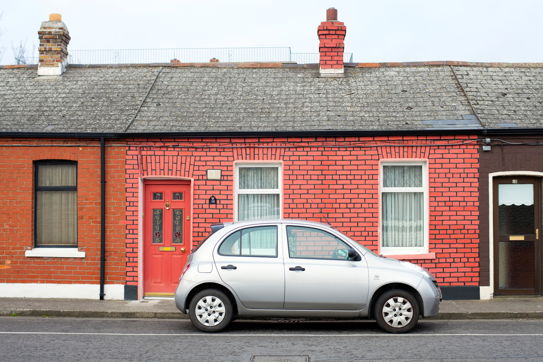
Driving Petrol and Diesel Cars
Source Solution Health Effect

Slide 18
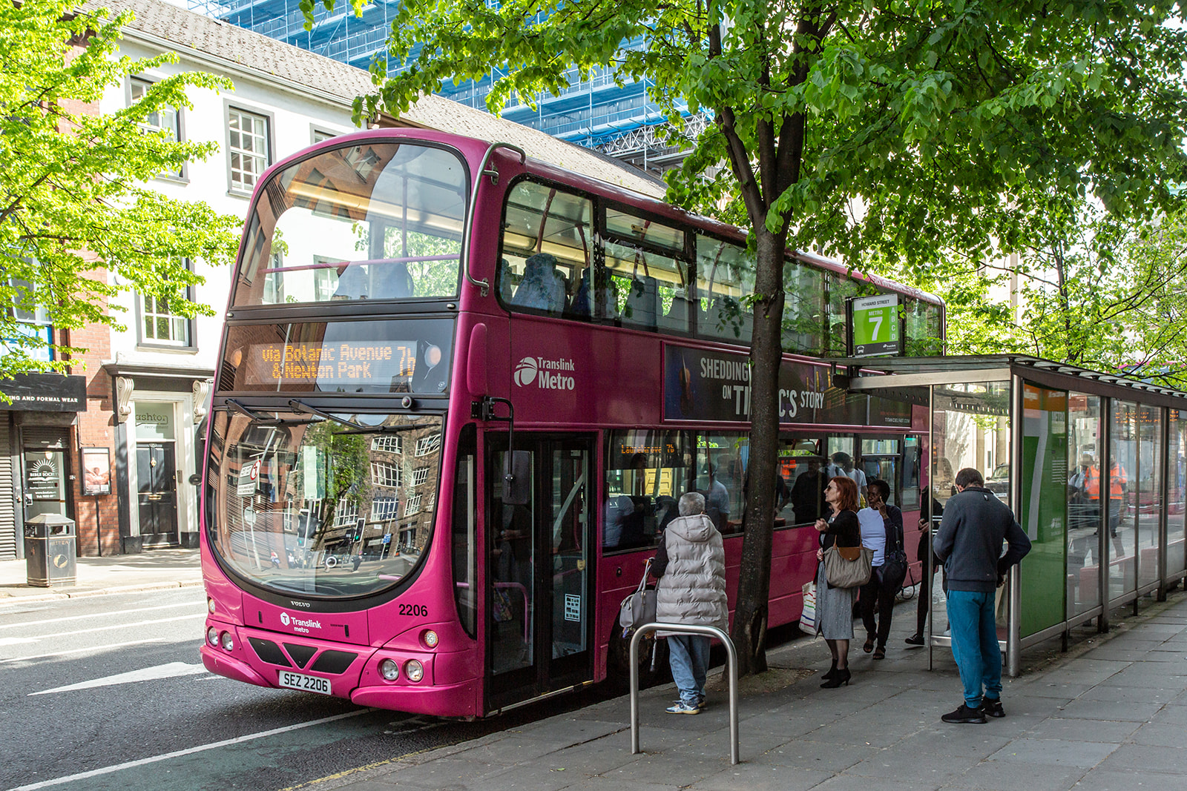
Public Transportation
Source Solution Health Effect

Slide 19
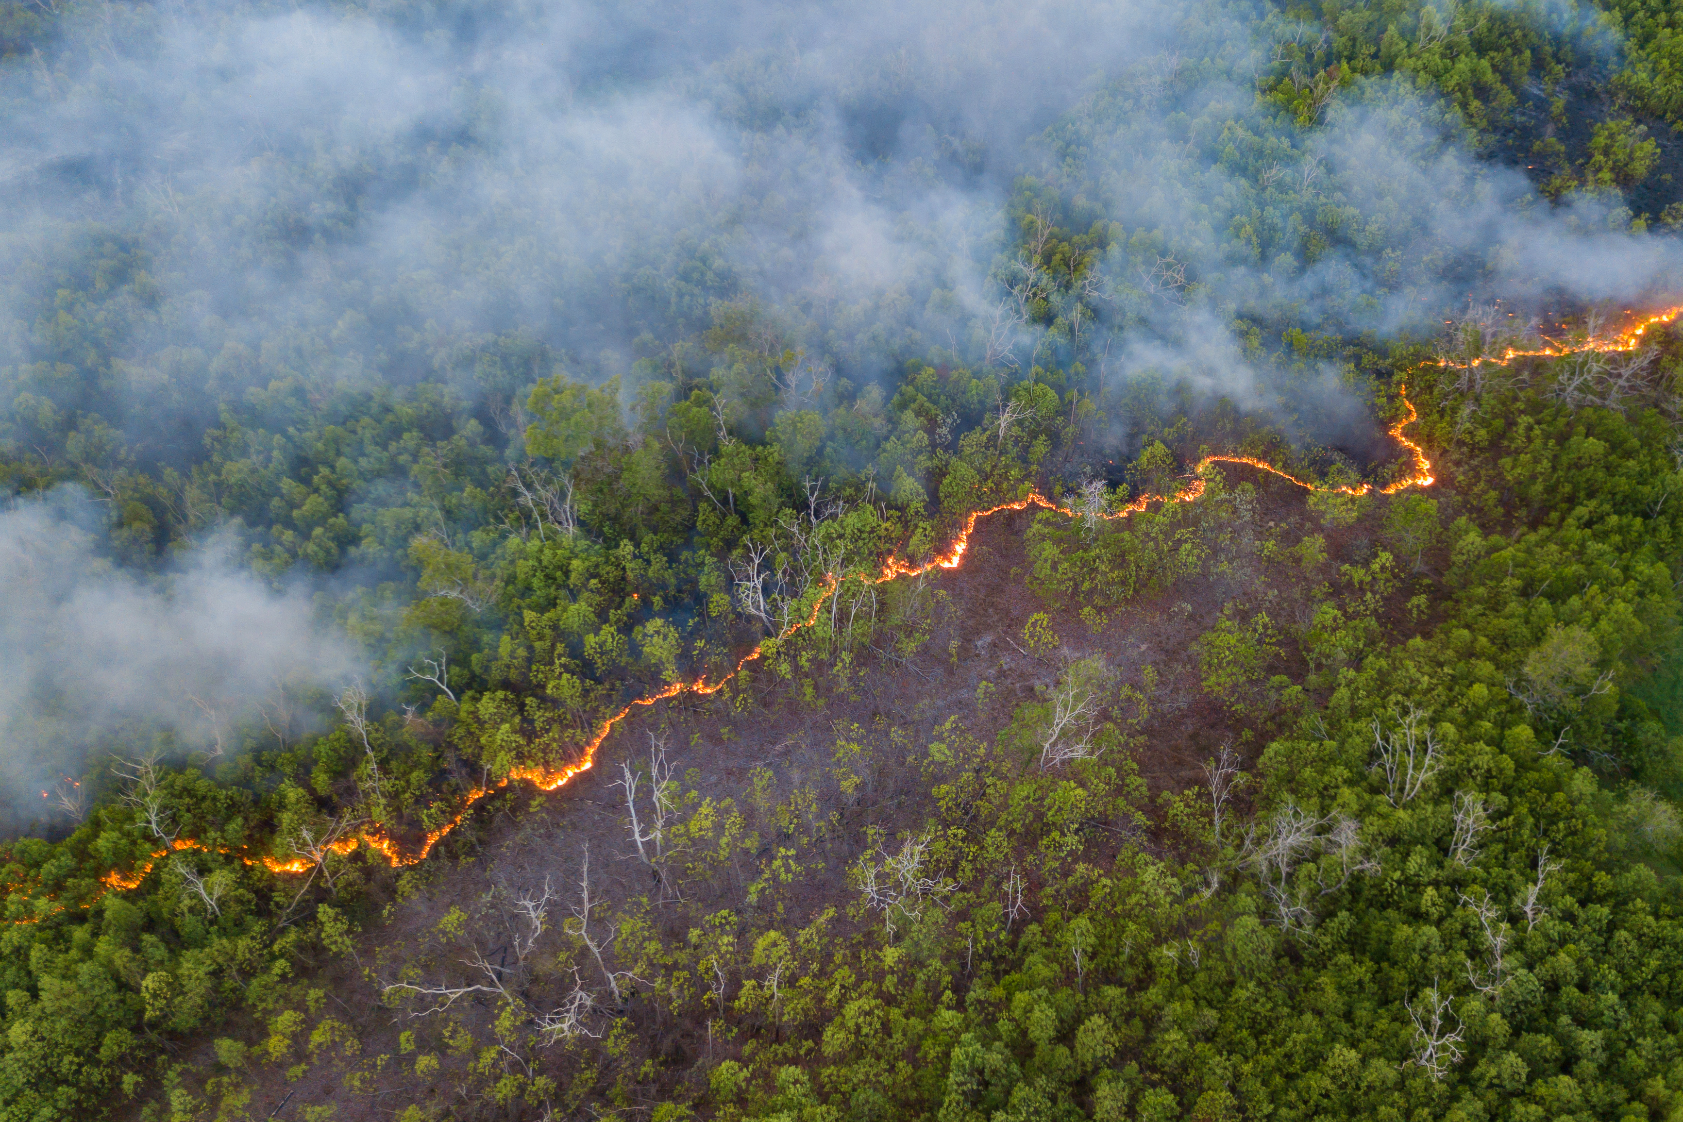
Natural Disasters
Source Solution Health Effect
Notes:
Forest fires, dust storms, volcanos

Slide 20
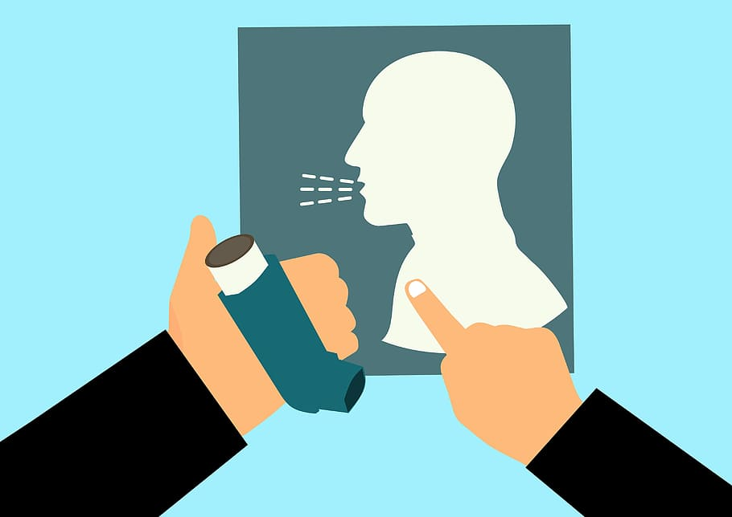
Make Asthma Worse
Source Solution Health Effect

Slide 21
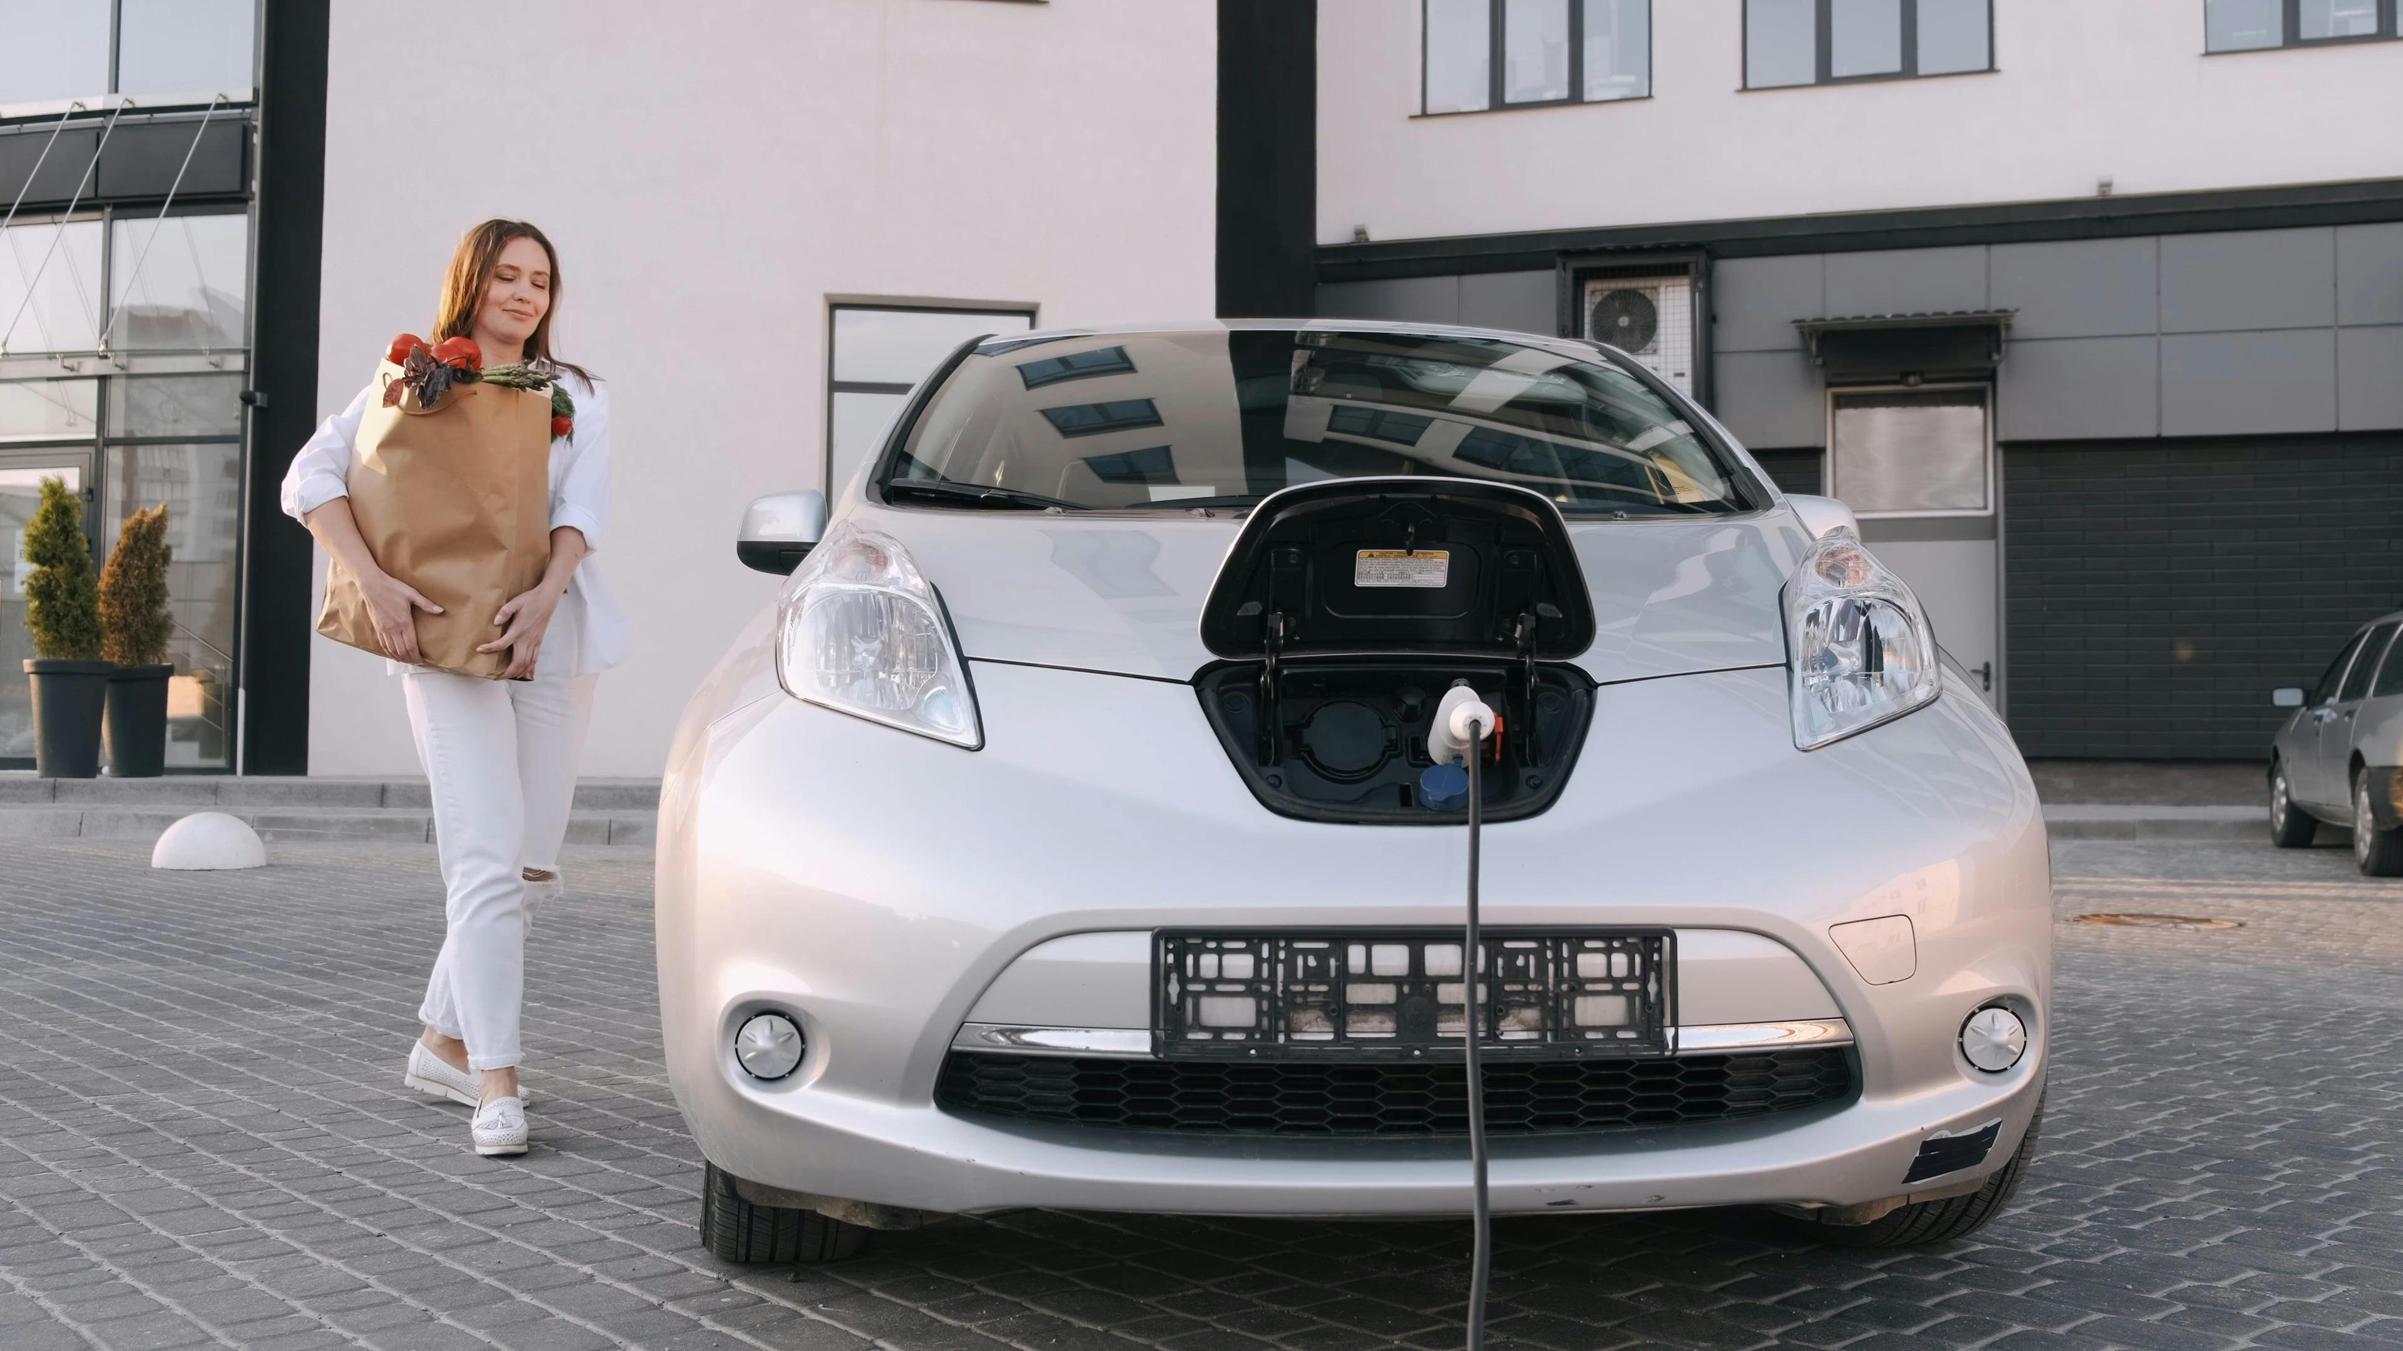
Electric Cars
Source Solution Health Effect

Slide 22
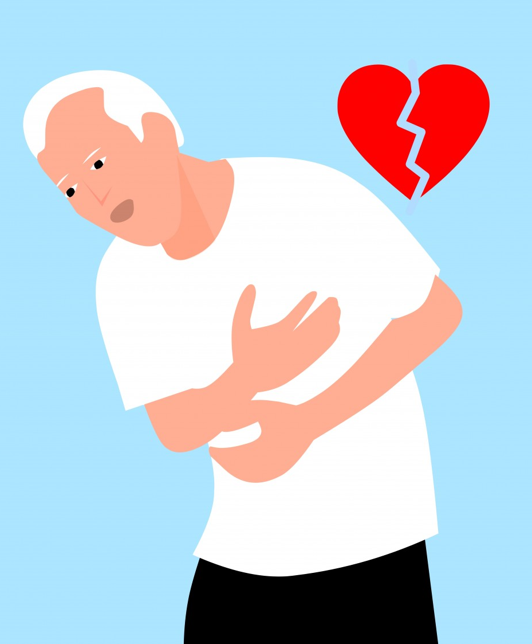
Hurts Your Heart
Source Solution Health Effect

Slide 23
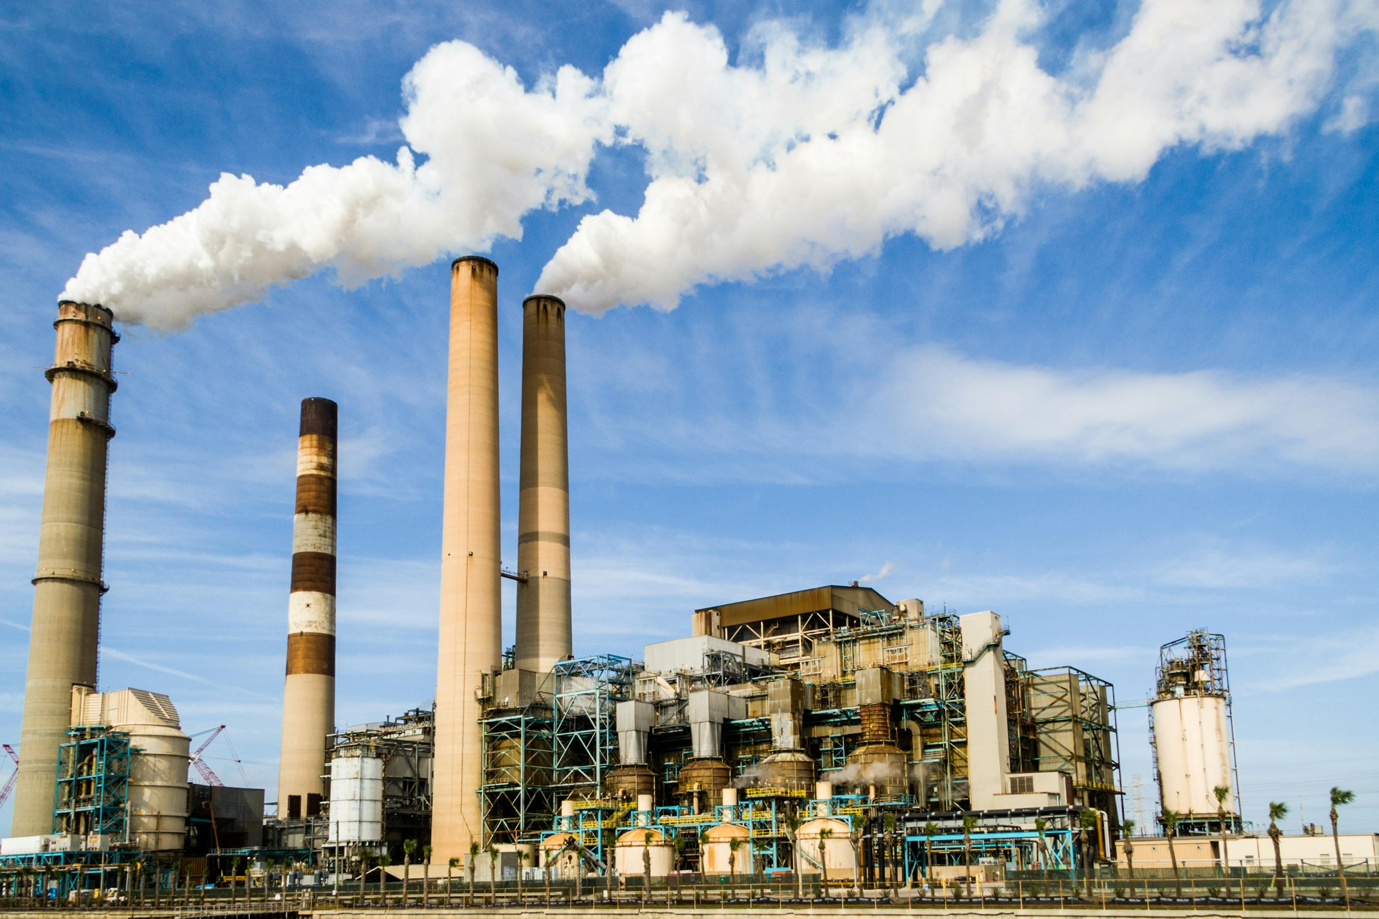
Factories
Source Solution Health Effect

Slide 24
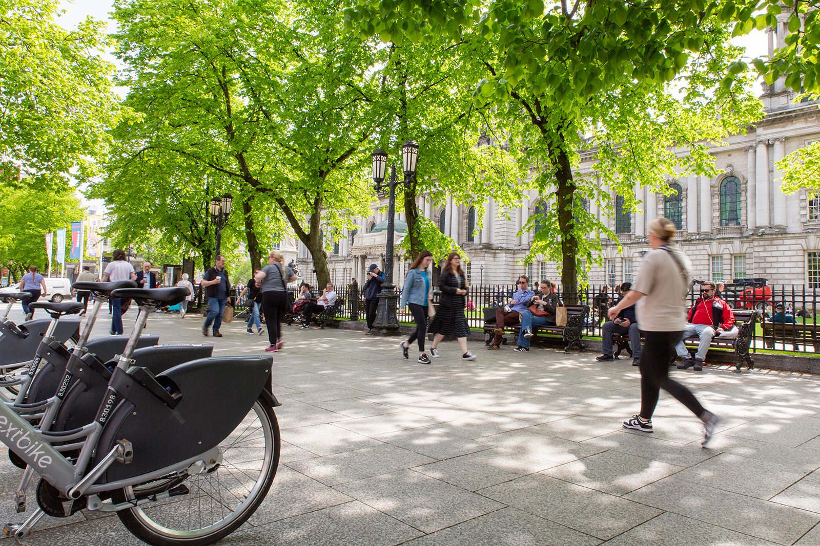
Walking and Cycling
Source Solution Health Effect

Slide 25
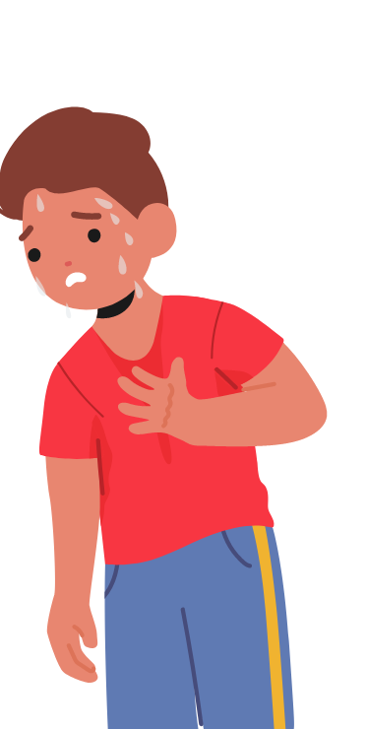
Makes it Harder to Breath
Source Solution Health Effect

Slide 26
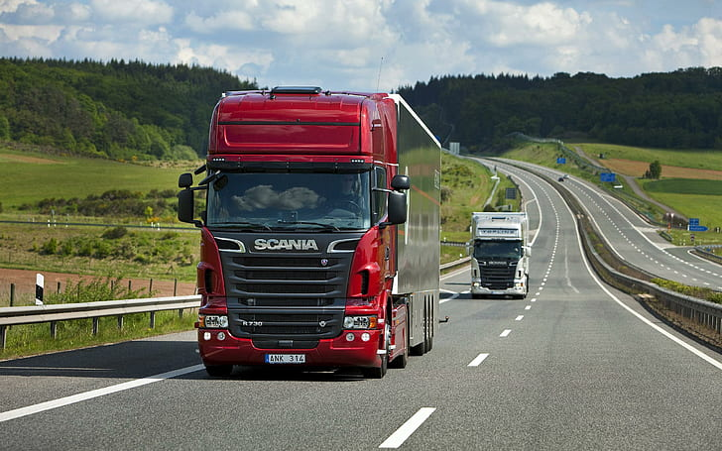
Lorries
Source Solution Health Effect

Slide 27
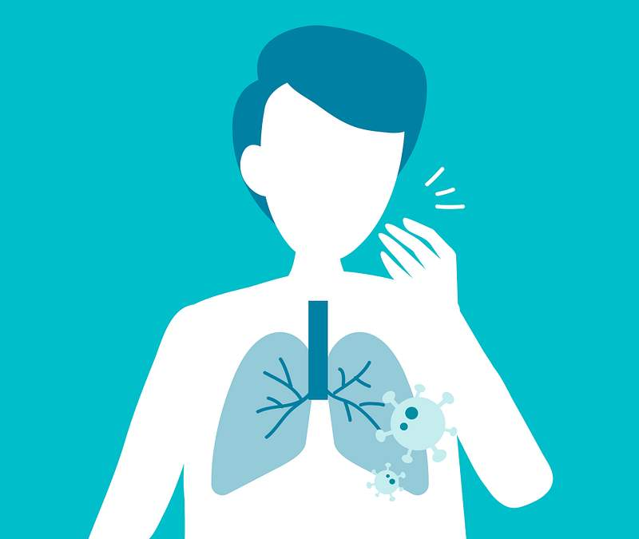
Coughing
Source Solution Health Effect

Slide 28
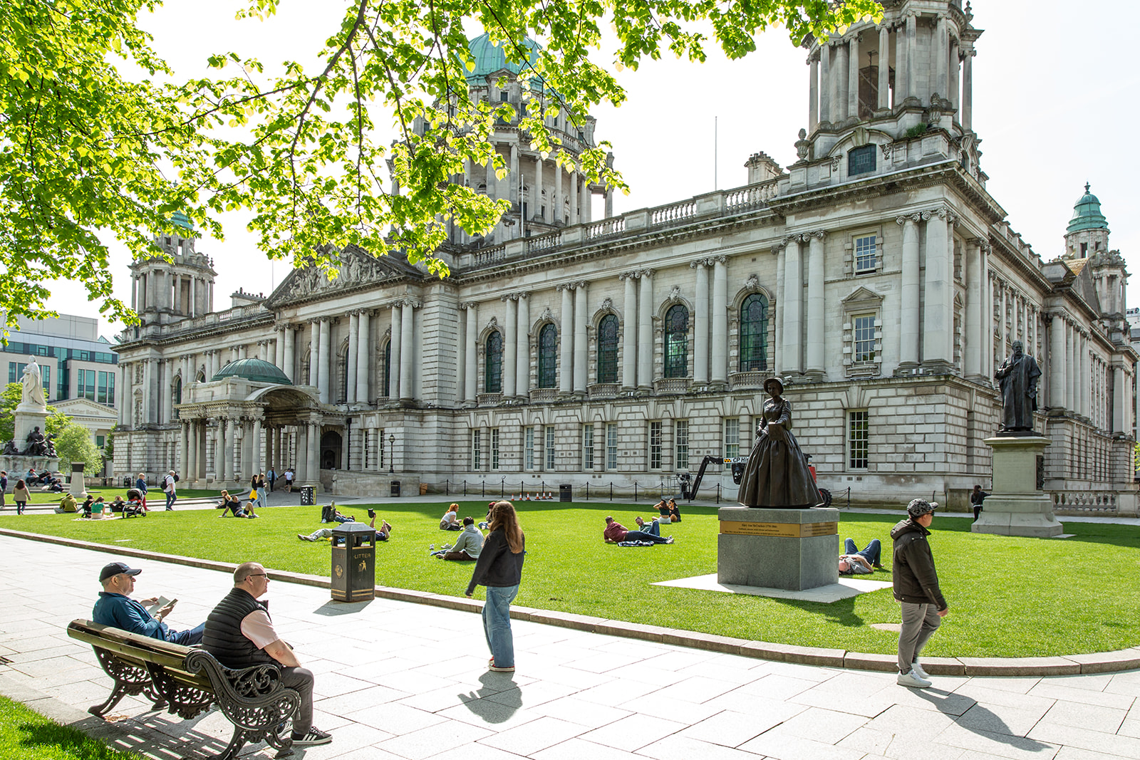
More Green Space
Source Solution Health Effect

Slide 29
Source Solution Health Effect
Head Shoulder Knees
Alternative Activity

Slide 30


Source Solution Health Effect
Walk Stop Run
Alternative Activity

Slide 31
DIY Pollution Catcher
Air Pollution: Learning Activity B
Notes:
See the Key Stage 2 Booklet for Instructions

