Slide 1

Healthy Transport
Unit 2

Slide 2





Unit 2: Transport

Slide 3

KS 2 Transport: Learning Activity A
https://www.bbc.co.uk/teach/class-clips-video/articles/zs6d239
Notes:
See Key Stage 2 Booklet for Instructions
More specific types of transportation, useful for KS1 : https://www.bbc.co.uk/teach/class-clips-video/articles/zxjsydm

Slide 4
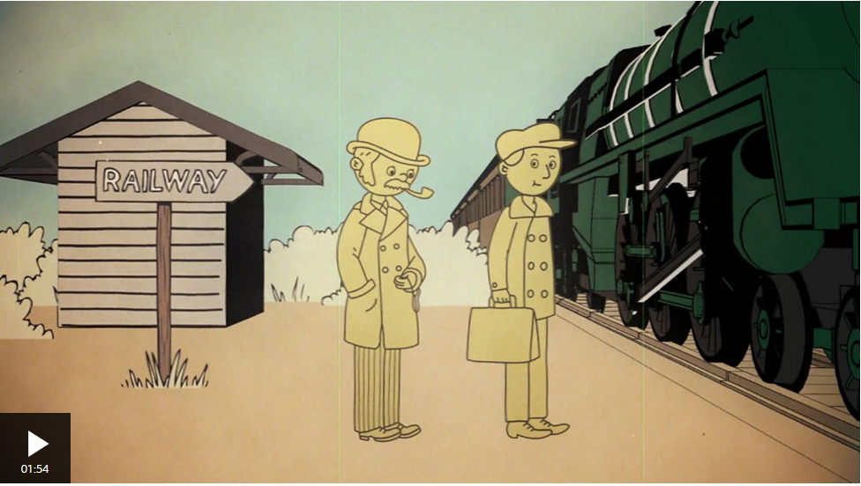
KS2: Transport: Learning Activity A
https://www.bbc.co.uk/teach/class-clips-video/articles/z7cccmn

Slide 5
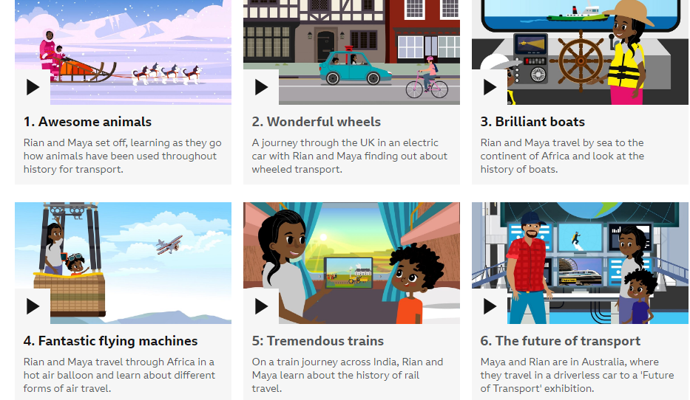
(Optional Videos)
KS1 Transportation: Learning Activity A
https://www.bbc.co.uk/teach/class-clips-video/articles/zxjsydm
Notes:
See Key Stage 1 Booklet for Instructions

Slide 6
Transportation Past and Present
KS2 Transport: Learning Activity A
Notes:
See Key Stage 2 Booklet for Instructions

Slide 7
Modes of Travel

Slide 8
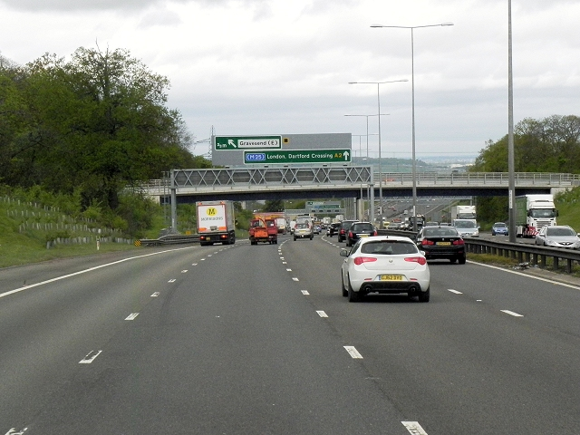
Cars
Most popular form of travel
Quick and easy to get from place to place
Fuelled by petrol or diesel
Releases harmful gas and chemicals
into the air causing air pollution
Bad for the environment
This Photo by Unknown Author is licensed under CC BY-SA
Notes:
Discuss what are the pros and cons of using cars, which of them bullet points are pros and cons?

Slide 9
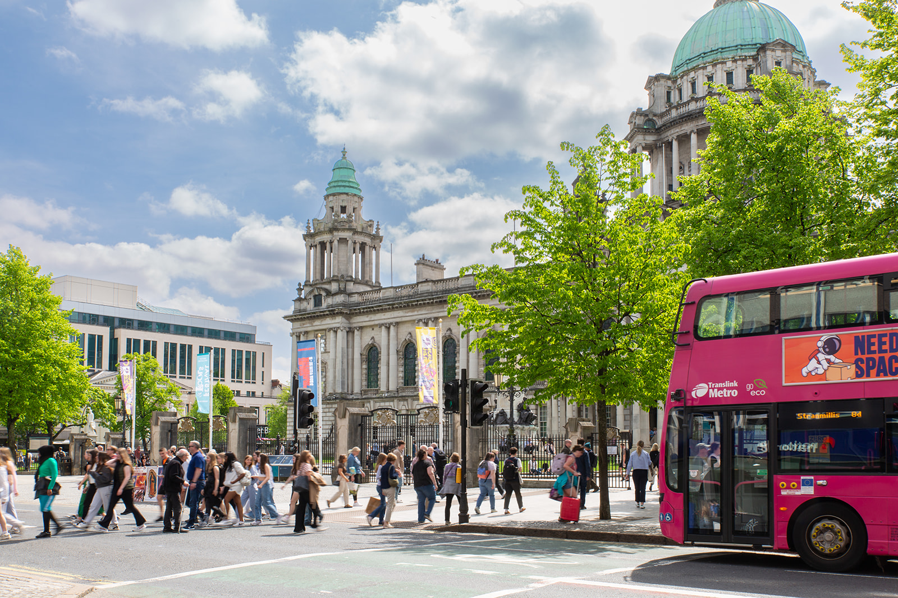
What is Sustainable Transport?
Transportation that is:
  Low cost
  Good for the environment
  Safe
Notes:
Sustainable transport are buses, trains, walking, cycling

Slide 10
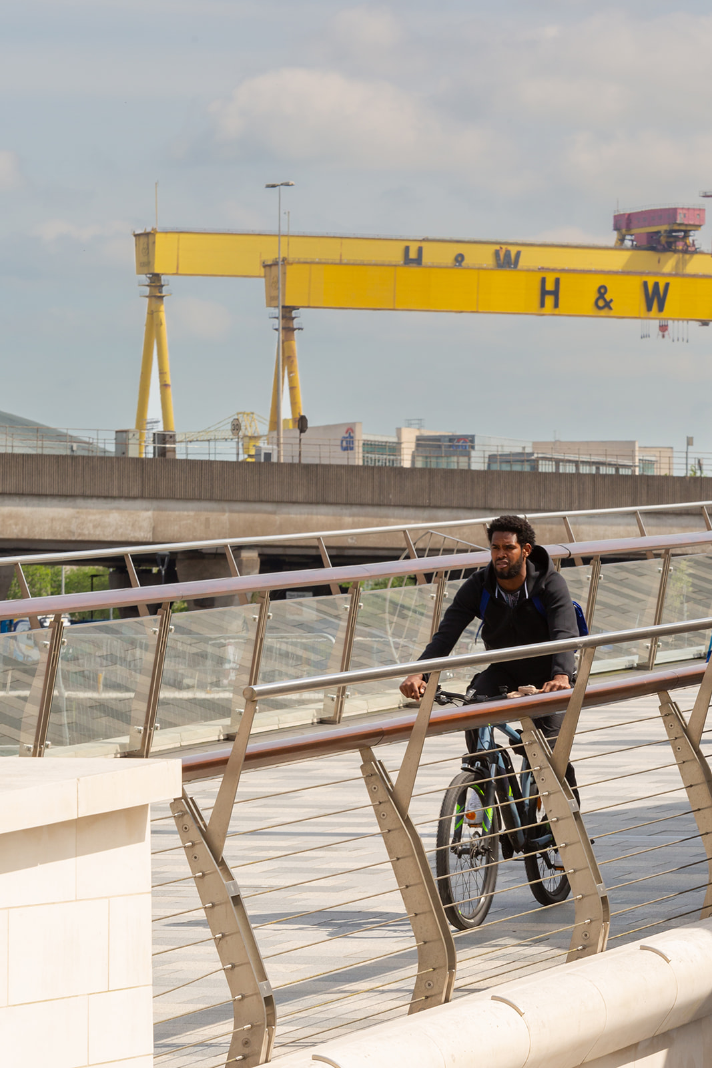
Walking & Cycling
Cost £0
Good for our minds
Gives us time to exercise
Good for the environment
Doesn’t cause air pollution
Notes:
What are the pros and cons of walking and cycling from place to place?
Opportunity to discuss how our environment impacts our ability to walk and cycling safely: clean, good lighting, wide footpaths, crossings, greenways, well kept pavement etc.
Can discuss how walking and cycling is not always easy, some people with disabilities or older ages might have trouble walking or cycling

Slide 11
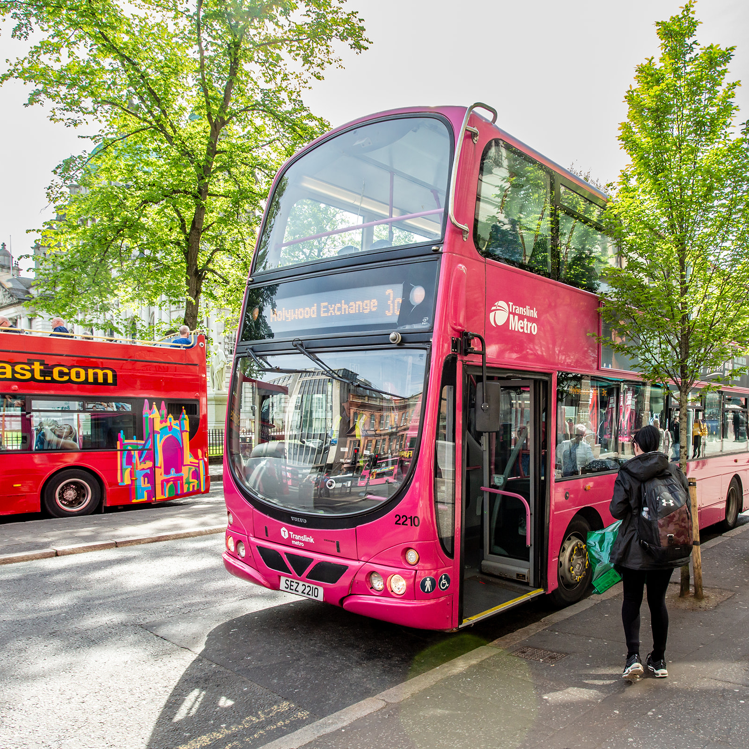
Public Transport
Buses
Trains
Glider
Easy to use
Lots of options
Cost less
More public transportation =less cars= less air pollution
Better for environment if powered by electricity than petrol or diesel
Notes:
Pros and cons of public transport
How many students take public transport places?

Slide 12
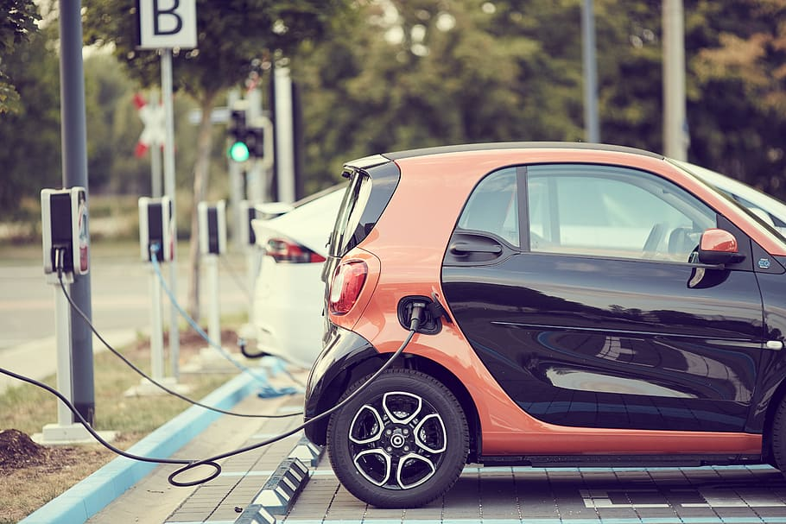
Electric Cars
Quick to get from place to place
Use a battery to power the engine
Plug it into an electric source to charge the battery
Good for the environment because doesn’t cause air pollution
Expensive
Notes:
Pros and cons of electric cars
Important to note that electric we use to power our homes, charge our phones or cars can come from a factory that causes air pollution so not the best option for the environment
Need to have charging points in car parks to help get from place to place, especially far from home

Slide 13
Transportation Debate
KS2 Transport: Learning Activity B
Notes:
See Key Stage 2 Booklet for Instructions

