Slide 1

Healthy Transport
Units 3-5

Slide 2

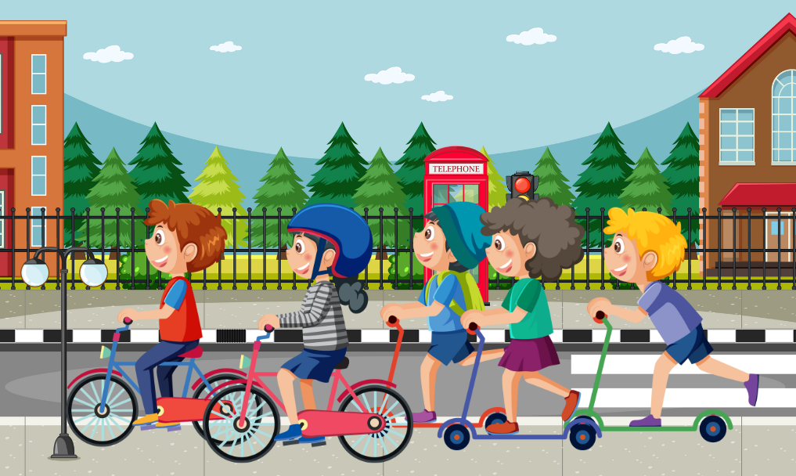
Unit 3: Active Travel

Slide 3
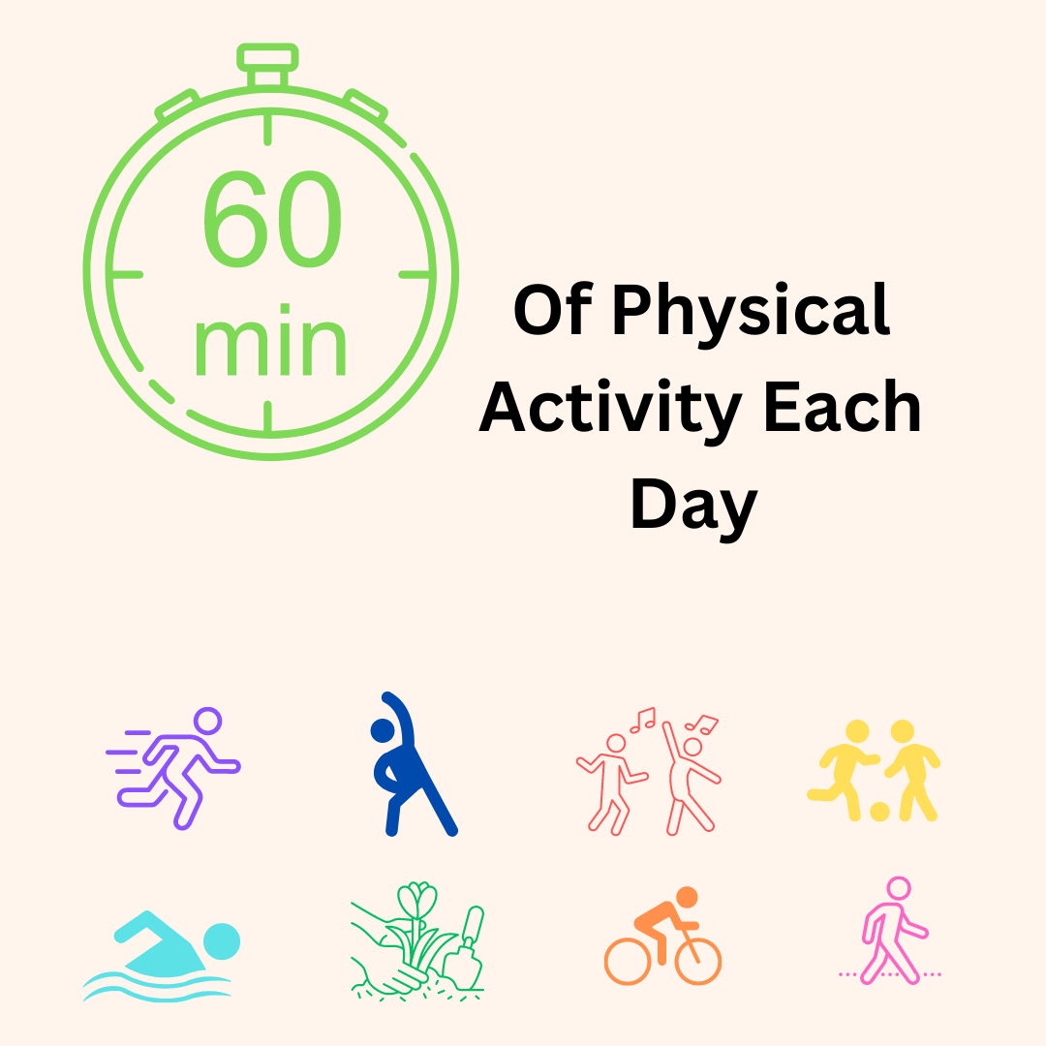
Exercise
Benefits:
Healthier body
Healthier mind
Stronger bones and muscles
Better sleep
More focused and energised
Less stress
Spend time with friends
Notes:
The World Health Organization recommends children and adolescents aged 5-17 years need at least an average of 60 minutes per day of moderate to vigorous physical activity¹¹. Moderate activity are those activities which raise your heart rate, make you feel warmer and breathe faster. It is recommended that children include a variety of types of physical activity each week such as walking, jumping, running, sports, dancing and physical education.¹²
What happens inside your body when you exercise?¹³
Body temperature increase when your muscles heat up making you feel warm
Heart beats faster to pump blood to the muscles you are using, this blood carries oxygen to your muscles
Lungs work harder to make you breath faster so blood can pick up more oxygen from your lungs and bring it to your muscles which are working harder so they need more oxygen
NHS (2021) Benefits of exercise, https://www.nhs.uk/live-well/exercise/exercise-health-benefits/
British Heart Foundation (2017). What happens when you exercise video, https://www.bhf.org.uk/informationsupport/heart-matters-magazine/activity/what-happens-when-you-exercise

Slide 4
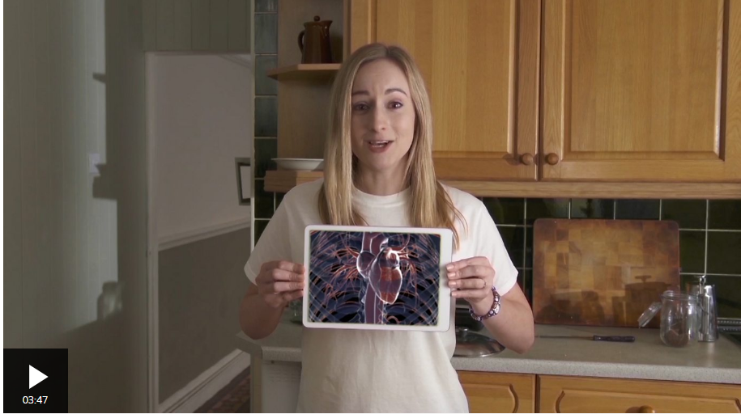
Your Heart and Exercise
https://www.bbc.co.uk/teach/class-clips-video/articles/zhf76v4
Notes:
See Key Stage 2 Booklet for Instructions

Slide 5
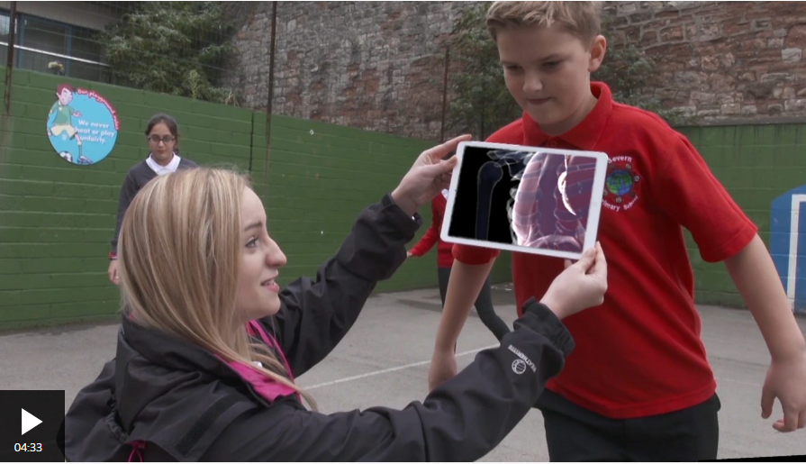
Your Lungs and Exercise
https://www.bbc.co.uk/teach/class-clips-video/articles/z7t8qp3
Notes:
See Key Stage 2 Booklet for Instructions

Slide 6
KS 2 Active Travel: Learning Activity A
What Happens to My Body, When I am Active?
Notes:
See Key Stage 2 Booklet for Instructions

Slide 7

What is Active Travel?
Traveling using the human power of physical active.

Slide 8
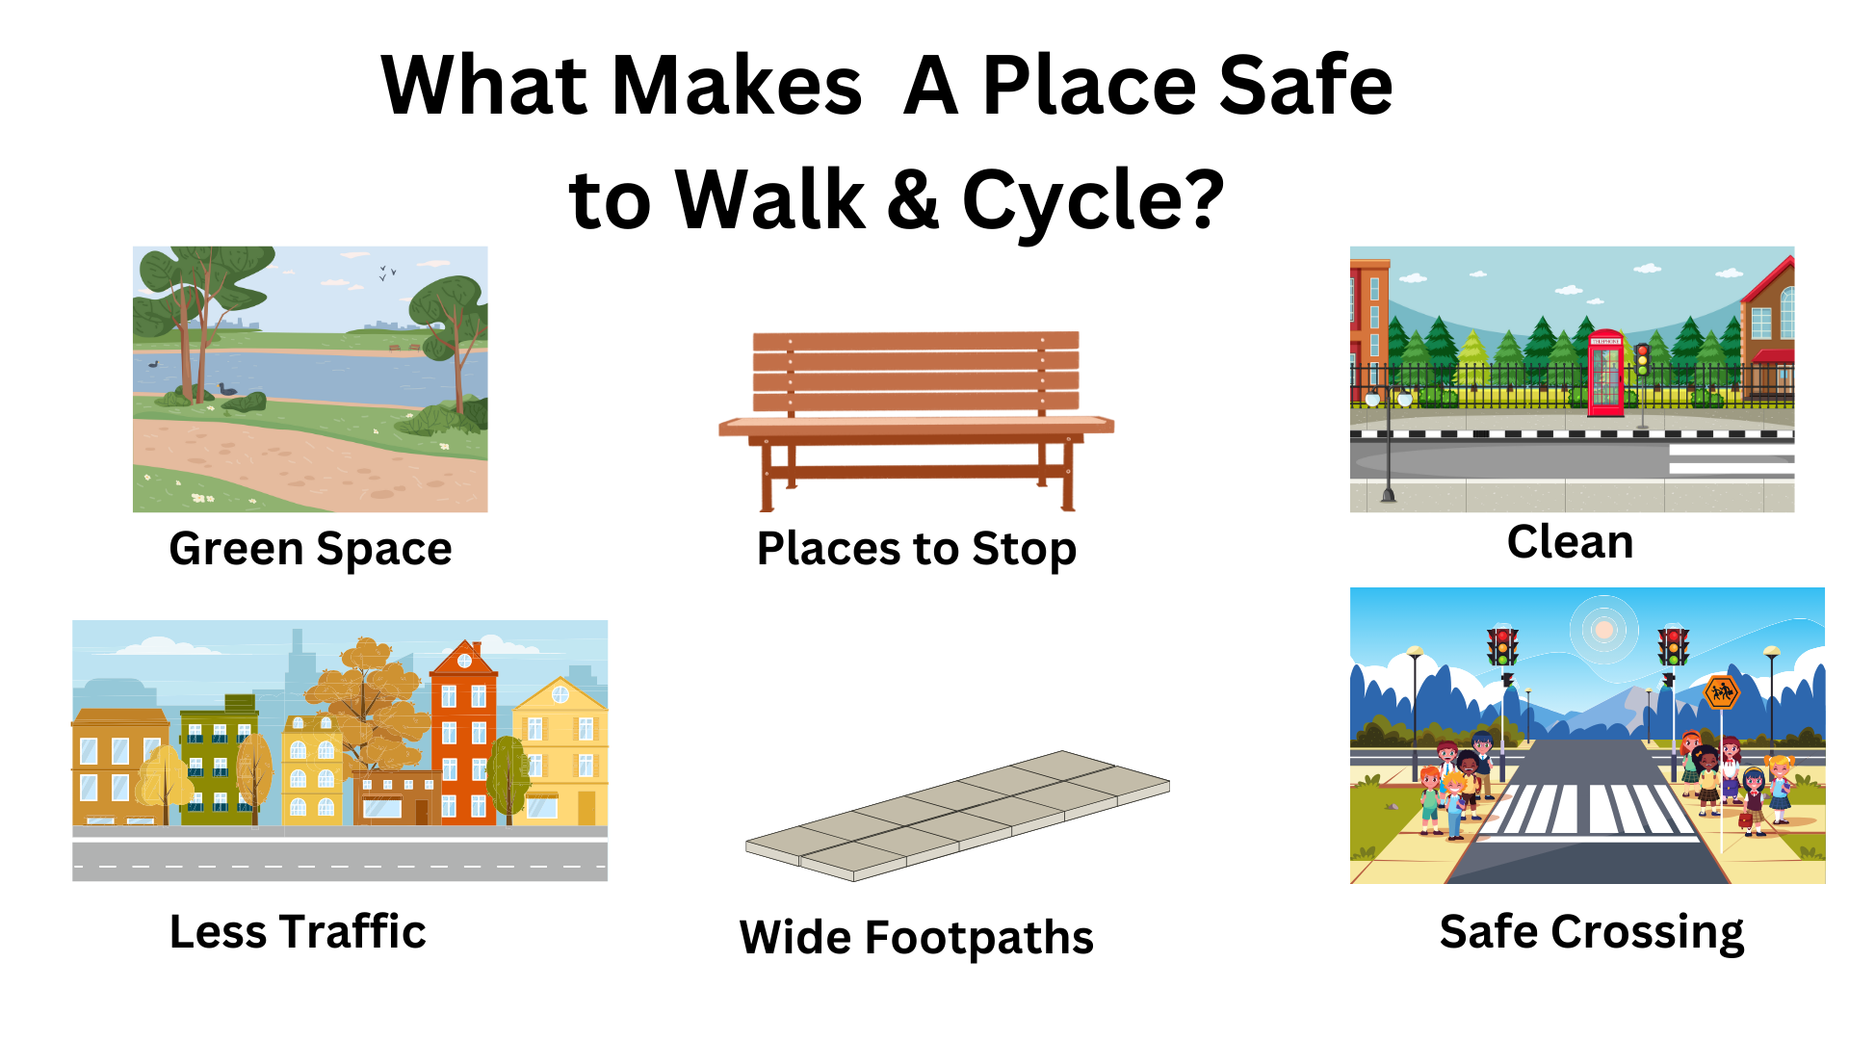
Notes:
In order to be able to walk and cycle from place to place it is important to have spaces and places that make it easy and safe to walk and cycle
Does your neighbourhood have any of these?
Do you think it would be safe to walk and cycle to school? Why or why not? Ex: there are safe crossing or we need wider footpaths

Slide 9


Health Benefits of Walking & Cycling
Healthy body
Good for mental health
Become stronger and fitter
Better heart health
Lower risk of developing cancer
Notes:
Walking and cycling are forms of transport that get individuals outside and exercising. Walking and cycling to places such as school can assist with incorporating physical activity into one’s everyday routine

Slide 10
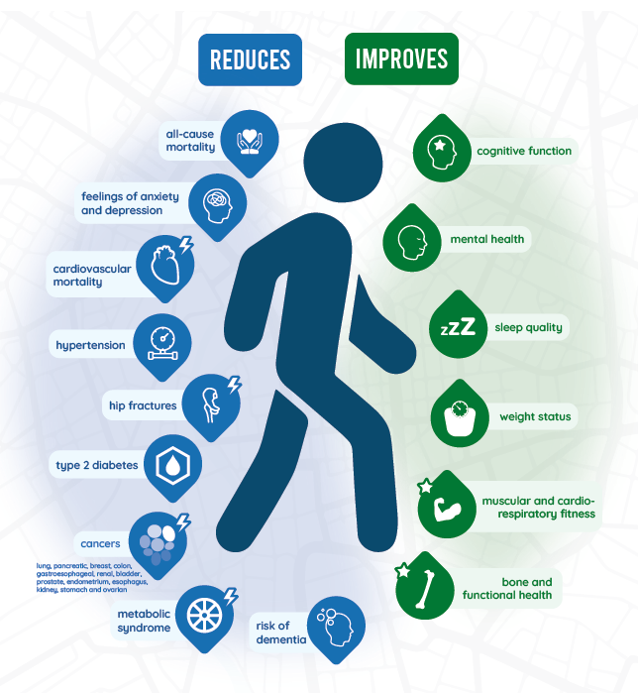
Health Benefits Walking & Cycling
Notes:
Lots of benefits to walking and cycling
More focused, happier, stronger mind
Lower risk of getting sick or serious illnesses
Stronger bones, muscles, and healthier body

Slide 11
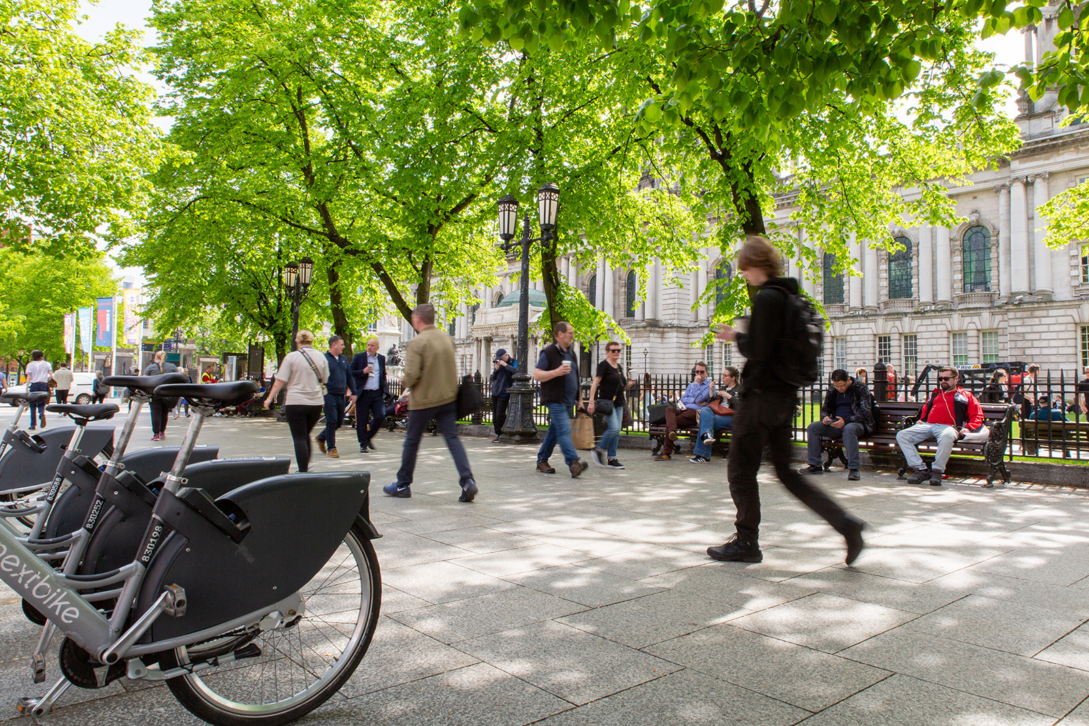
Environmental Benefits of Walking & Cycling
Less people using cars= less air pollution, less noise pollution and lower carbon emissions
Healthier built environments: more green spaces, more cycle paths, and better footpaths
Notes:
Walking and cycling instead of taking a car keeps cars off the road, this reduces the amount of air pollution released from cars. Which as we have discussed is important for keeping the air we breath clean and healthy
Air pollution causes climate change so when we walk and cycle we help fight climate change
As we have discussed we need elements to make it safe to walk and cycle, these are part of our built environment or the area we spend time in, when we walk and cycle more communities can be changed to create healthier environments that make it safe to walk and cycle

Slide 12
Active Travel Poster
KS1 Active Travel: Learning Activity B
Notes:
See Key Stage 1 Booklet for Instructions

Slide 13
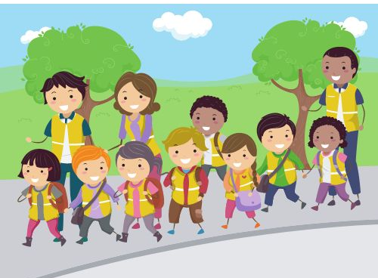
Unit 4: School Travel

Slide 14
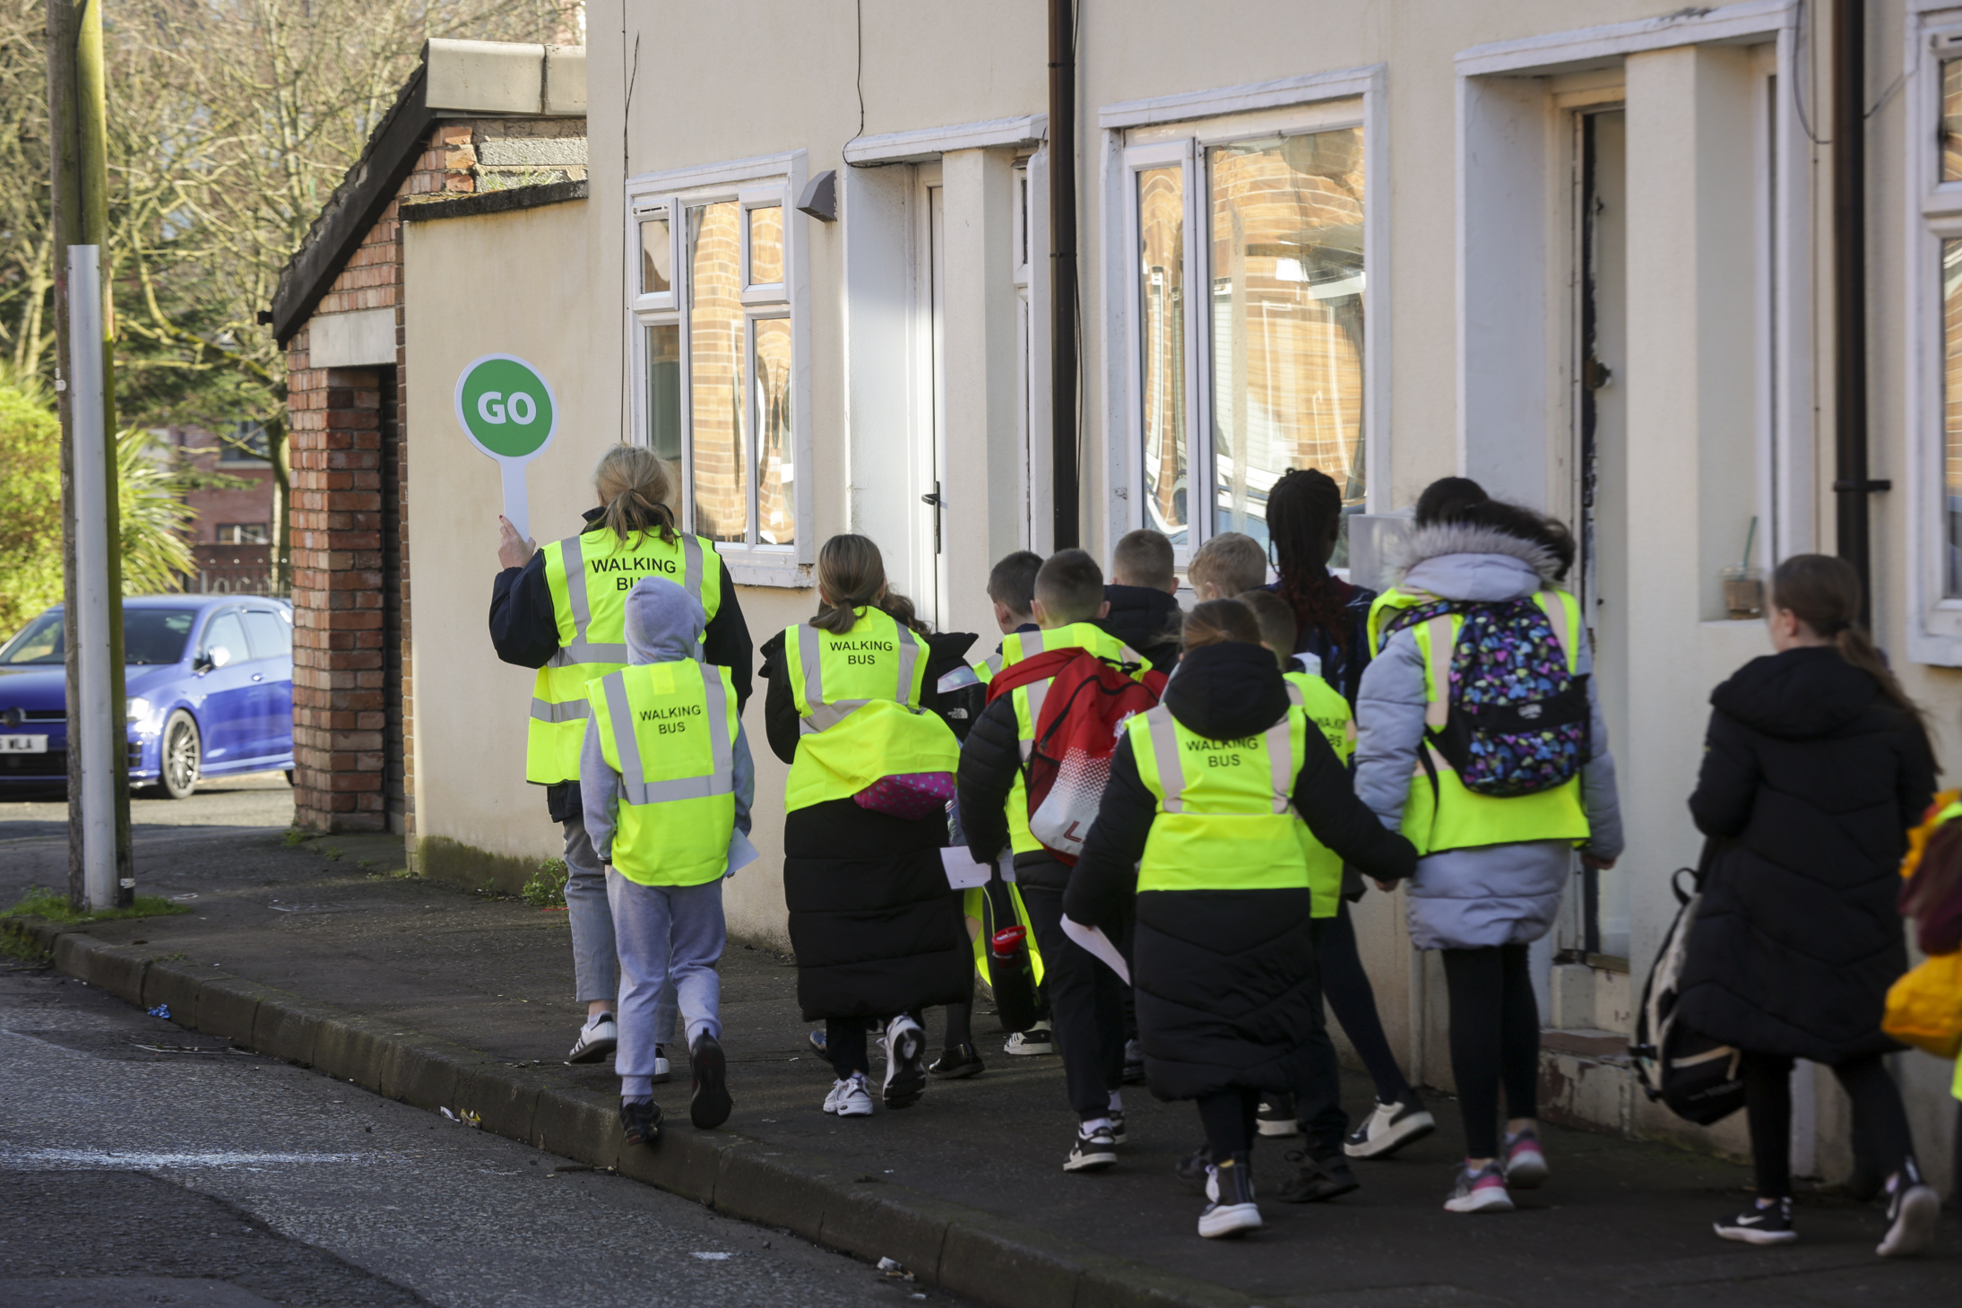
Active Travel to School
Walking or cycling with family
Walking or cycling with friends
With a Walking Buses
Notes:
We can walk and cycle to school as a healthier more environmentally friendly options to travel to school

Slide 15
Class Travel Survey
KS2 School Travel: Learning Activity A
Notes:
See Key Stage 2 Booklet for Instruction

Slide 16
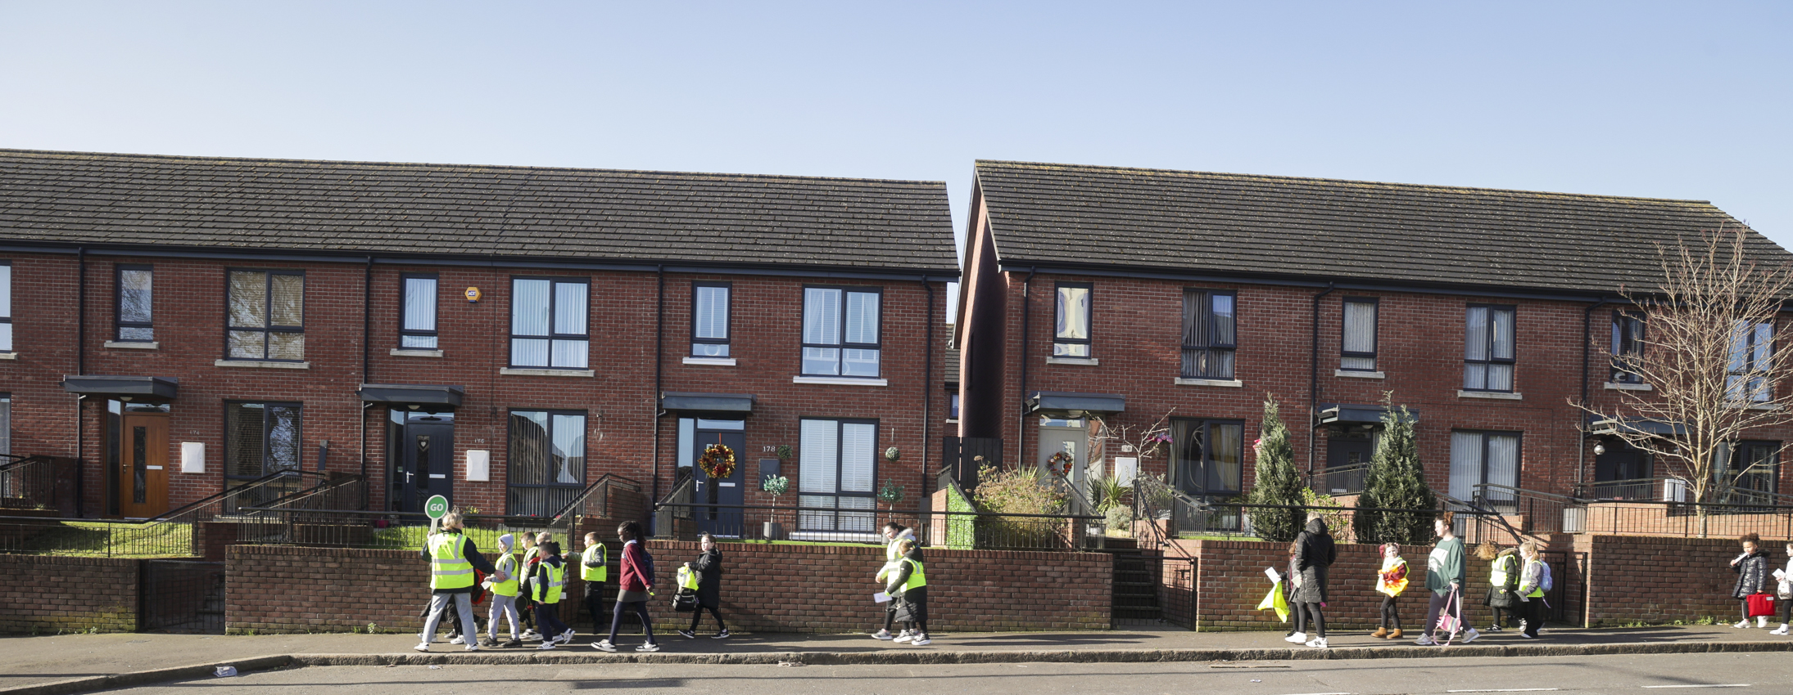
What is a Walking Bus?
A group of children who walk with two adults wearing a high visibility vest using a special safe route to school. They stop along the way to pick up more children at different bus stops.
Notes:
One way you can walk to school is if your school has a walking bus. Children who walk to school can spend time walking and talking with friends, spend time outdoors, get exercise, come to school more refreshed and ready to focus.

Slide 17
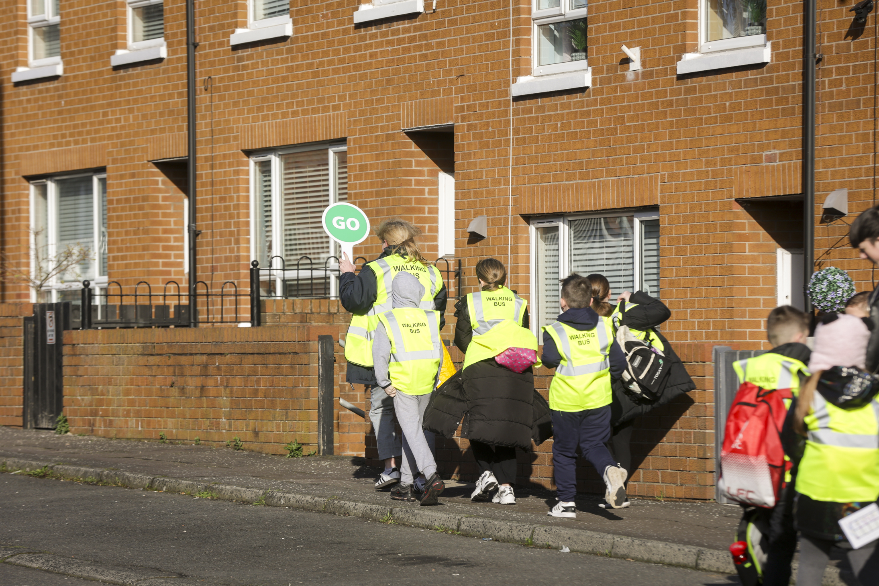
Steps to create a Walking Bus
Create a safe route to school
Find adults to walk with
Plan a schedule for the Walking Bus
Encourage students to use the Walking Bus
Keep the Walking Bus fun and exciting
Notes:
Use this an opportunity to introduce the students into the concepts of how to create a walking bus, get them thinking about what people and resources they might need. How they could convenience other children to walk to school and ways to keep the walking bus fun and exciting ( tickets for no homework, classroom parties etc. )

Slide 18
Design A Walking Bus Route
KS2 School Travel: Learning Activity B
Notes:
See Key Stage 2 Booklet for Instructions

Slide 19
Promote A Walking Bus
KS2 School Travel: Learning Activity C
Notes:
See Key Stage 2 Booklet for Instructions

Slide 20

Unit 5: Road Safety

Slide 21

KS2 School Travel: Learning Activity A
https://www.roadsafeni.org/new-green-cross-code-video/
Notes:
See Key Stage 2 Booklet for Instructions

Slide 22
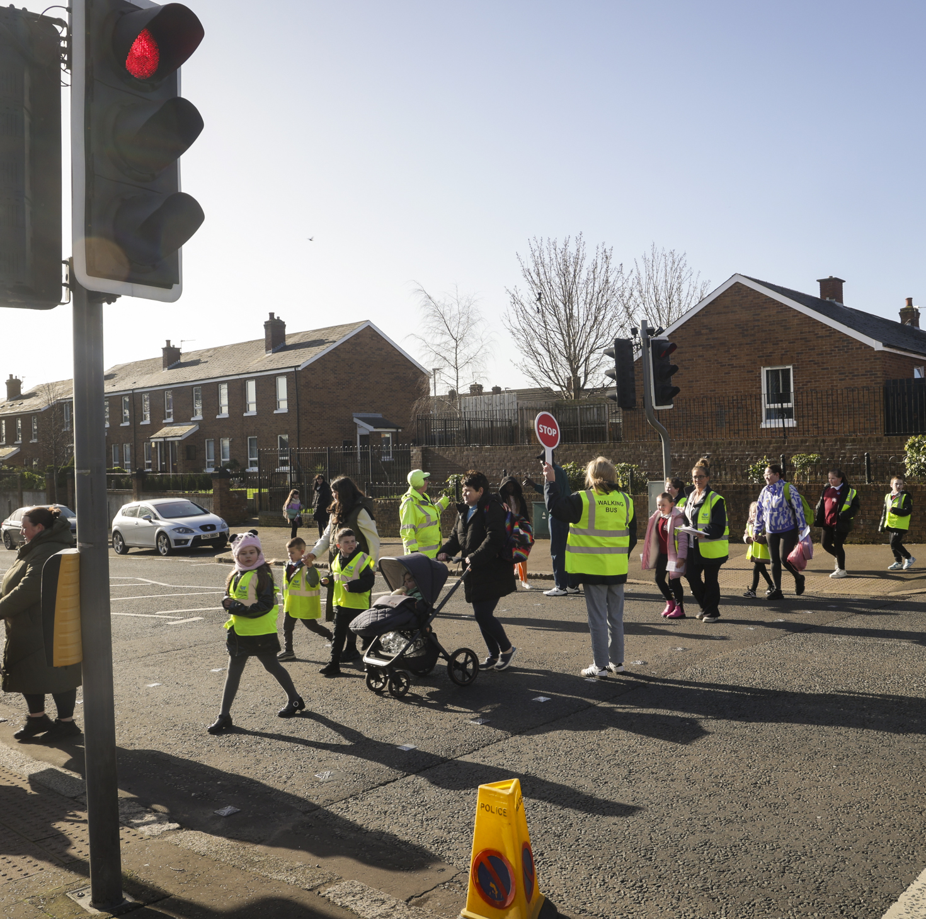
Green Cross Code
Find a safe place to cross, then stop.
Stand on the pavement near the kerb.
Look all around for traffic and listen.
If traffic is coming, let it pass. Look all around again.
When there is no traffic near, walk straight across the road.
Keep looking and listening for traffic while you cross.
Notes:
Follow these steps when crossing the road
https://www.nidirect.gov.uk/articles/road-safety-seven-11-year-olds#:~:text=Using%20crossings-,Teach%20your%20child%20to%3A,or%20other%20people%20are%20crossing

Slide 23




When Crossing:
Listen
Look
Think
Notes:
The most important thing to remember when cross is to ………If you are unsure wait until you are confident it is okay to cross, if possible find a crossing area and wait for the green man to appear to walk

Slide 24
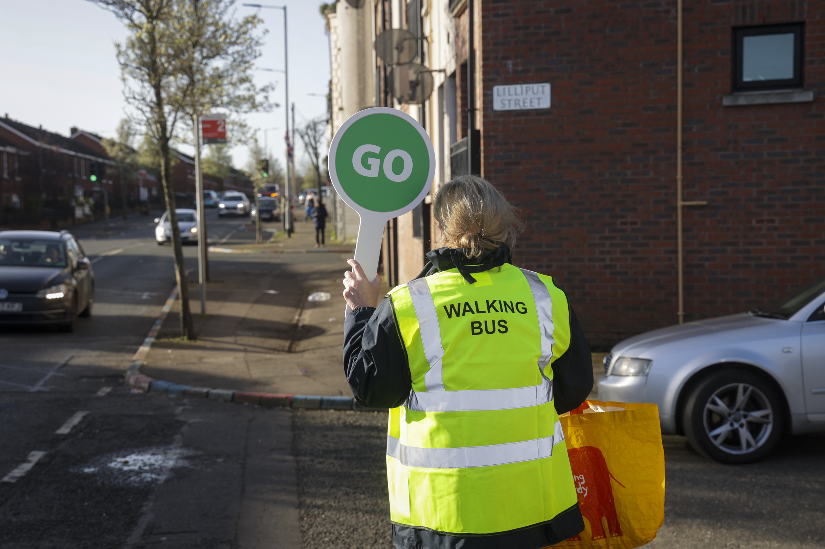
Be Safe, Be Seen
Bright colours day and night
White and reflective at night
Notes:
If we wear bright colour close, that are reflective it makes it easier for drivers to see us. This is especially important in the winter and at night.

Slide 25
Road Safety Poem Jingle
KS2 Road Safety: Learning Activity B Option 1
Notes:
See Key Stage 2 Booklet for Instructions

Slide 26
Road Safety School Poster
KS1 Road Safety: Learning Activity B Option 2
Notes:
See Key Stage 1 Booklet for Instructions

